Slide 1
Implementing Ocean Sound as an Essential Ocean Variable for the Global Ocean Observing System
Peter Tyack
University of St Andrews, Scotland
Woods Hole Oceanographic Institution
European Marine Board
38th Third Thursday Science Webinar
21 March 2024

Slide 2
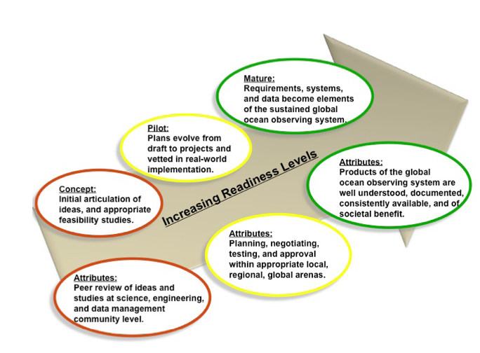
What is the Global Ocean Observing System – GOOS?
The global oceans are critical components of climate change.
GOOS was established in 1991 by the UN Intergovernmental Oceanographic Commission to support climate science as the observational backbone for operational forecast systems

Slide 3
FRAMEWORK FOR OCEAN OBSERVING
SOCIETAL ISSUES
DECISION GUIDANCE
WHAT TO MEASURE: ESSENTIAL OCEAN VARIABLES
GAPS??
INFORMATION PRODUCTS AND SERVICES
HOW TO MEASURE: SENSORS AND SCALES
DATA: INFRASTRUCTURE AND ASSEMBLY CENTERS
OBSERVATIONS: PLATFORMS FACILITIES AND MAINTENANCE

Slide 4
GOOS Focus Areas for Societal Issues
Climate: Modeling, mitigating, and adapting to climate change
Forecasts and Warnings: enables the timely, sustained and global flow of data for ocean hazard early warnings and weather and ocean forecasting.
Ocean Health: GOOS has broadened to assess marine biodiversity and the status of marine ecosystems using societally and scientifically relevant biological Essential Ocean Variables

Slide 5
GOOS Operational Platforms in May 2021

Slide 6
GOOS Essential Ocean Variables
GOOS expert panels in Ocean Physics and Climate, Biogeochemistry, and Biology and Ecosystems identify Essential Ocean Variables, based on:
Impact: the variable addresses climate, operational ocean services and ocean health and also contributes to understanding from a scientific perspective or application from a service perspective.
Feasibility: it is technically, politically and economically feasible to observe or derive the variable on a global scale using proven, scientifically understood methods.

Slide 7
GOOS Essential Ocean Variables that influence Ocean Sound are marked in Green informed from Ocean Sound are marked in Orange

Slide 8
GOOS Biology/Ecology Metadata Portal

Slide 9
Introduction to the Ocean Sound Essential Ocean Variable (EOV)
Developed by an International Quiet Ocean Experiment (IQOE) working group funded by Partnership for Observation of the Global Ocean (POGO).
Measurements: sound pressure p(t), particle motion (displacement, velocity, acceleration)
Platforms and systems: Cabled, Moored, Autonomous, Drifting, Towed, Animal Tags
Societal drivers and pressures from a GOOS perspective
Standardization and archiving of data
IQOE leads Implementation Plan
OCEAN SOUND EOV SPECIFICATION SHEET
Essential Ocean Variables (EOV) for the GOOS Biology and Ecosystems Panel AND Physics and Climate Panels:
Acoustic Environment
Authors: Peter Tyack
Panel reviewers: Christine Erbe, Dan Costa
Last updated Version 2018.05.05
https://goosocean.org/document/22567

Slide 10
Timeline for Development of Ocean Sound Essential Ocean Variable
Aug 2015 - June 2017 | POGO-supported IQOE Working Group that Drafted a Specification Sheet for Ocean Sound Essential Ocean Variable
June 2017 | Draft EOV approved by IQOE WG at its second meeting and sent to GOOS BIOECO panel
August 2017 | BIOECO led External Review of EOV
Fall 2017 | Revised EOV reviewed by all GOOS panels
August 2018 | Ocean Sound EOV accepted by GOOS BIOECO panel
Fall 2018 | IQOE designated to lead implementation of Ocean Sound EOV and forms Implementation Plan Committee
Summer 2019 - Spring 2020 | Funding approved from POGO (July 2019) and Lounsbery Foundation (spring 2020) for Implementation Plan Committee and Workshop
December 2020 | First (virtual) meeting of Implementation Plan Committee

Slide 11
Ocean Sound EOV Implementation Committee
Tasks of Committee
Write an implementation plan for the Ocean Sound Essential Ocean Variable, based on Global Ocean Observing System (GOOS) guidelines.
Input from IQOE working groups and the global ocean acoustics and bioacoustics communities
Interface with the GOOS Biology and Ecosystems Panel regarding the committee's work.
Report to the IQOE Science Committee and sponsors (SCOR and POGO)
Members
Peter Tyack, chair (UK)
Tom Akamatsu (Japan) Olaf Boebel/Karoline Thomisch (Germany) Lucille Chapuis (UK) Elisabeth Debusschere (Belgium) Christ de Jong (Netherlands) Christine Erbe (Australia) Karen Evans (Australia) Jason Gedamke (USA) Tess Gridley (South Africa) Georgios Haralabus (Austria) Reyna Jenkins (Canada) Jennifer Miksis-Olds (USA) Hanne Sagen (Norway) Frank Thomsen (Denmark)
Liaisons
Patricia Miloslavich (SCOR)
Sophie Seeyave (POGO)
Staff
Ed Urban (IQOE)
Timeline
2021 2022 2023 2024
Committee Committee Draft Revision Final
Formed Drafting Released Release

Slide 12
Using Sound to Measure Ocean Variables
OCEAN SOUND EOV
PLANKTON
& FISH
BACKSCATTER
BIOLOGICAL PARAMETERS
BIO/ECO EOVS
INVERTEBRATES
FISH
MARINE MAMMALS
HUMAN
ACTIVITIES
OCEAN
ACOUSTICS
ACTIVE ACOUSTICS
(Involves producing sound)
PASSIVE ACOUSTIC MONITORING
NUCLEAR EXPLOSIONS
MILITARY SONAR
SEISMIC SURVEY
SHIP NOISE
BATHYMETRY
SEASURFACE HEIGHT
SUBSURFACE TEMPERATURE
SUBSURFACE CURRENTS
SEA ICE
SEA STATE (WAVES & WIND)
SEA ICE
EARTHQUAKES & TSUNAMIS
RAIN
PHYSICAL PARAMETERS
PHYSICS EOVS

Slide 13
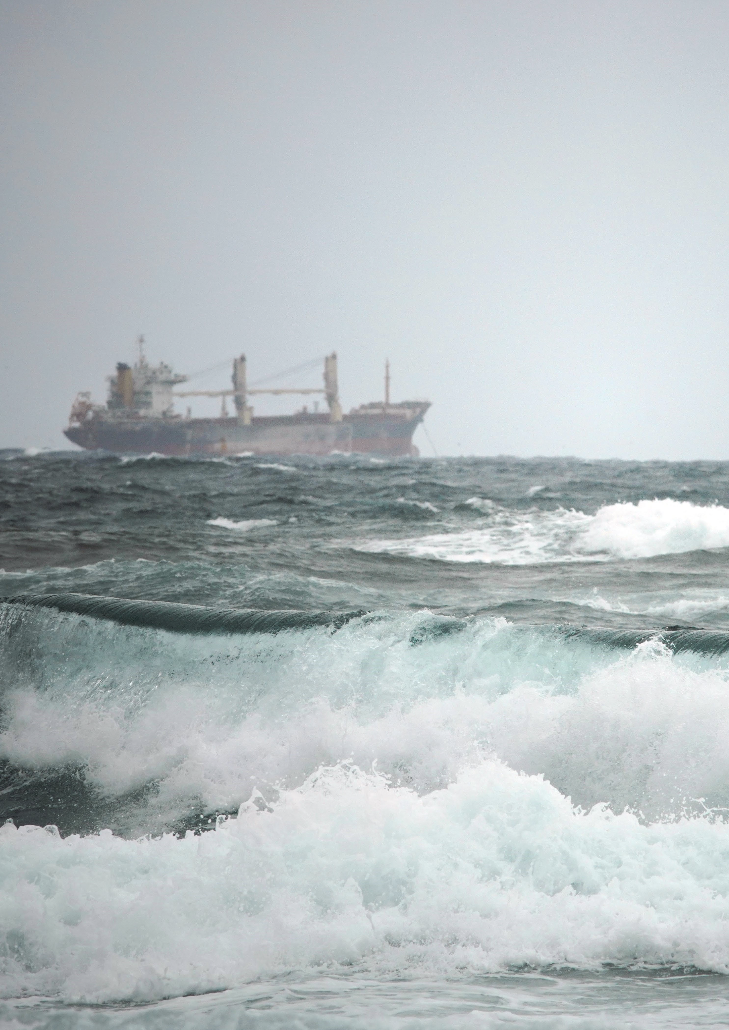
Outline of Ocean Sound EOV Implementation Plan
Introduction
Measurements and Derived Data Products to meet Goals
Modes of Deploying Acoustic Sensors for Ocean Observation
Tailoring Acoustic Observation Systems for Different Uses
Standards, Best Practice and Data Management
Governance and Funding
Tasks to implement ocean acoustic observations for GOOS

Slide 14
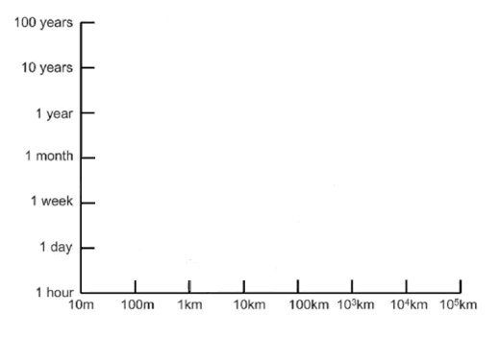
How to Measure the Ocean Sound EOV
A. GOOS GOALS
B. SPACE-TIME SCALES
C. SCALES FOR DEPLOYMENT MODES
Climate Change
Wind, Waves, Rain, Sea Ice
Ocean Health
Marine Ecosystems
Loss of Biodiversity
Distribution of Species
Impacts on Wildlife
Monitoring Threats
Earthquake/Tsunami
Naval Activities
Nuclear Explosions
Climate Change
Cabled Observatories
Ocean
Health
Fixed Autonomous
Mobile Autonomous
TIME
TIME
Ani-mal Tags
Vessel based
Monitoring Threats
SPATIAL EXTENT
SPATIAL EXTENT
Mature Systems: 11 acoustic sensors continuously monitor global oceans for nuclear explosions for decades

Slide 15
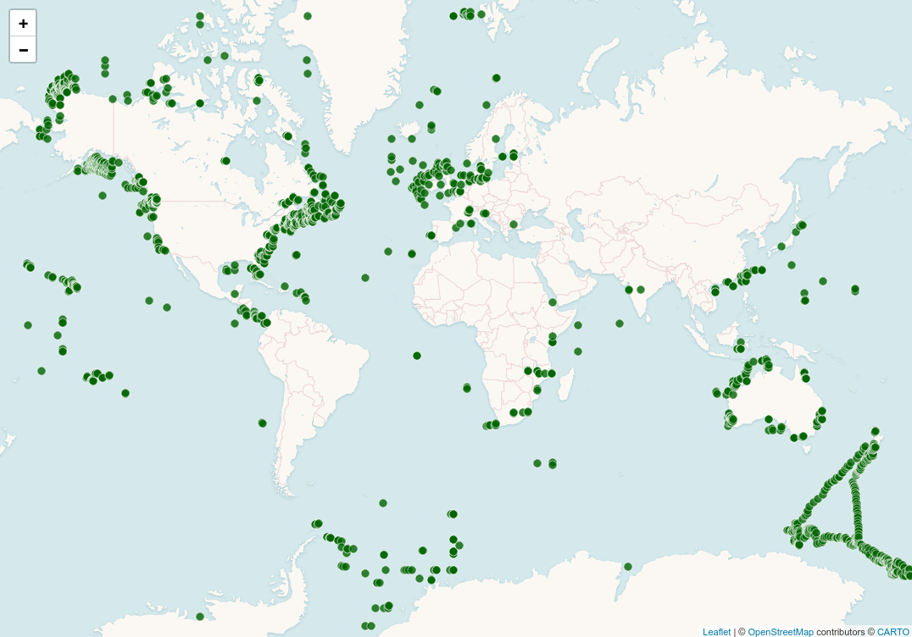
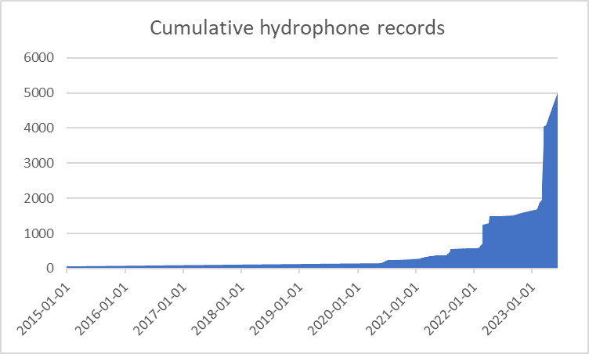
IQOE Metadatabase of underwater sound observations
Deployments are typically project specific
IQOE has organized geographically disparate groups of ocean acousticians from many disciplines
Accelerating pace of deployments
CUMULATIVE HYDROPHONE RECORDS
6000
5000
4000
3000
2000
1000
0
2015 2016 2017 2018 2019 2020 2021 2022 2023
RECORDING YEAR
https://www.iqoe.org/systems
Locations of underwater recordings in database from 1999-present

Slide 16
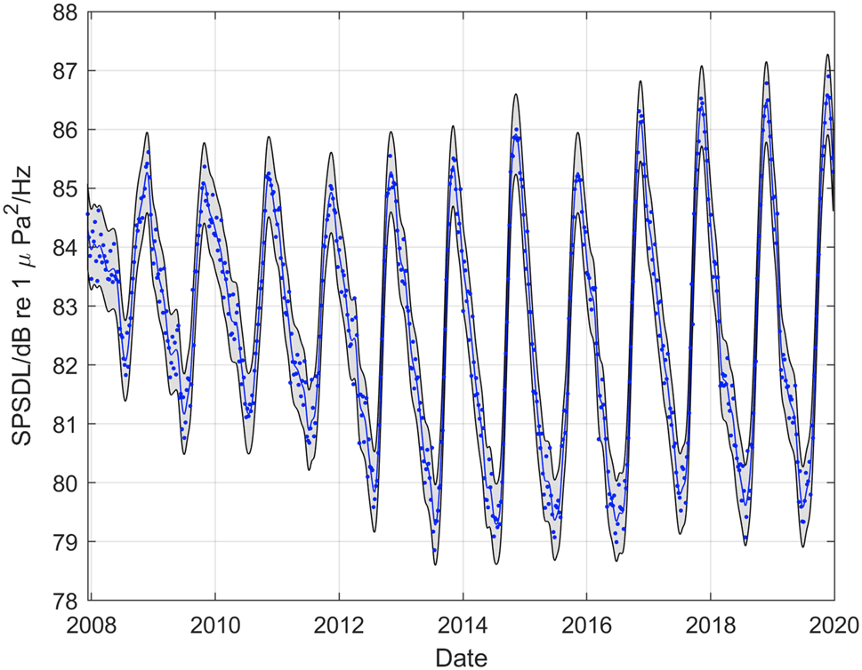
Comprehensive Test Ban Treaty Organisation Has Calibrated Hydrophone Array with Global Coverage for Decade-long Time Series
HA11 – Wake Island
SPSDL Sound Pressure Spectral Density Level
Robinson et al. 2023
https://doi.org/10.1038/s41598-023-31376-3

Slide 17
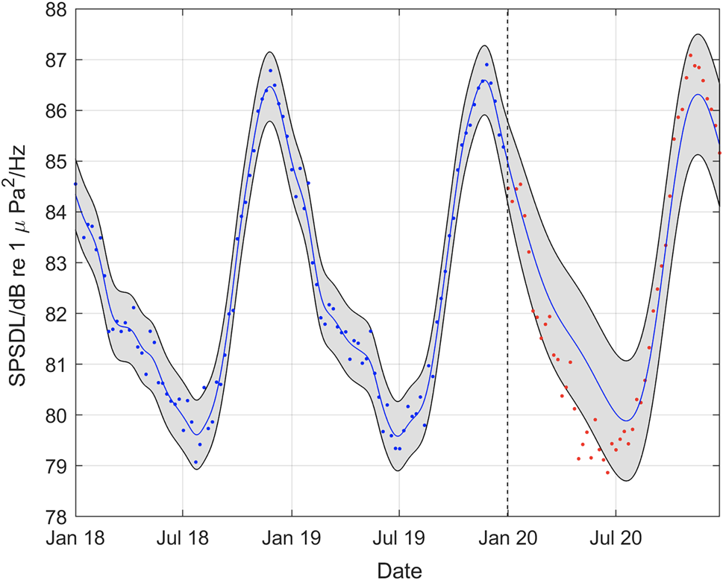
COVID Quieting:
Wake Island
Reductions in human seagoing activities reduced deep ocean noise during COVID (red dots Jan-Jul 2020) compared to predicted levels (blue line)
Robinson et al. 2023
https://doi.org/10.1038/s41598-023-31376-3

Slide 18
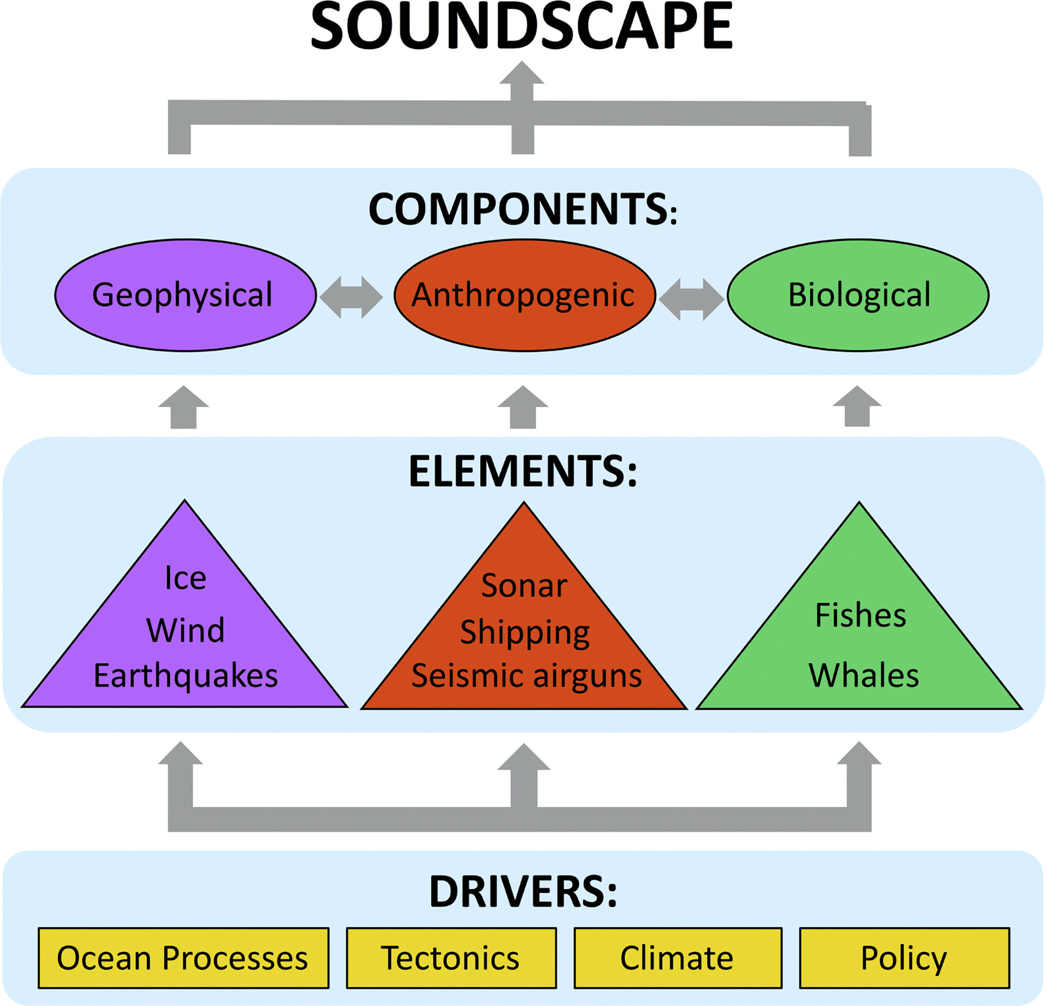
Ocean Soundscapes:
Characterization of environmental sound in terms of its spatial, temporal and frequency attributes, and the types of sources contributing to the sound field
Haver et al. 2017
https://doi.org/10.1016/j.dsr.2017.03.002

Slide 19
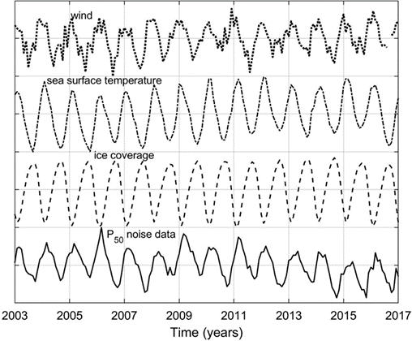
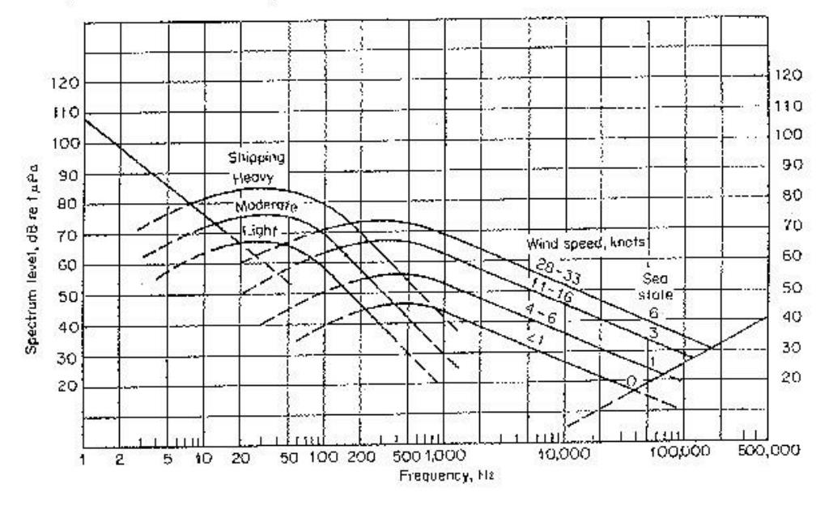
Shipping, Wind, and Surface Waves generate acoustic signatures
SHIPPING
WIND SPEED
Effects of Shipping and Wind on Deep-water Ocean Ambient Noise (”Wenz curves” circa 1960)
Robinson et al. 2019 UACE2019 - Conference Proceedings

Slide 20
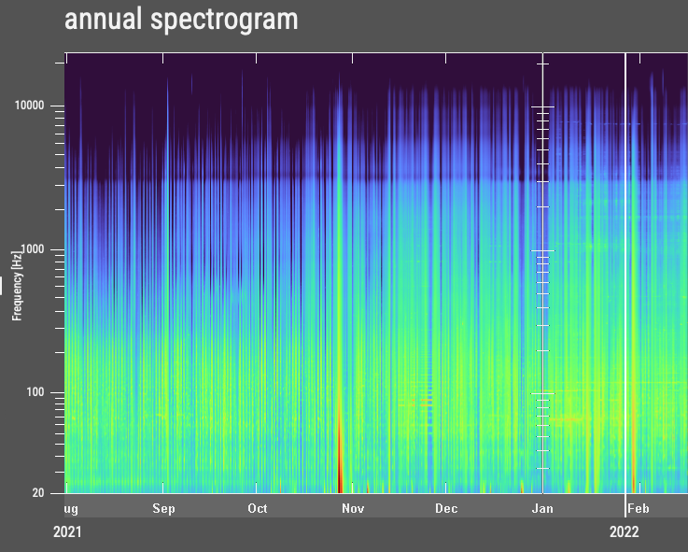
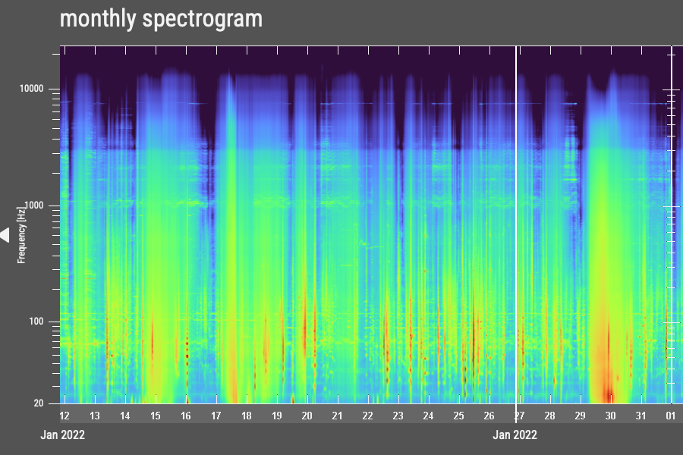
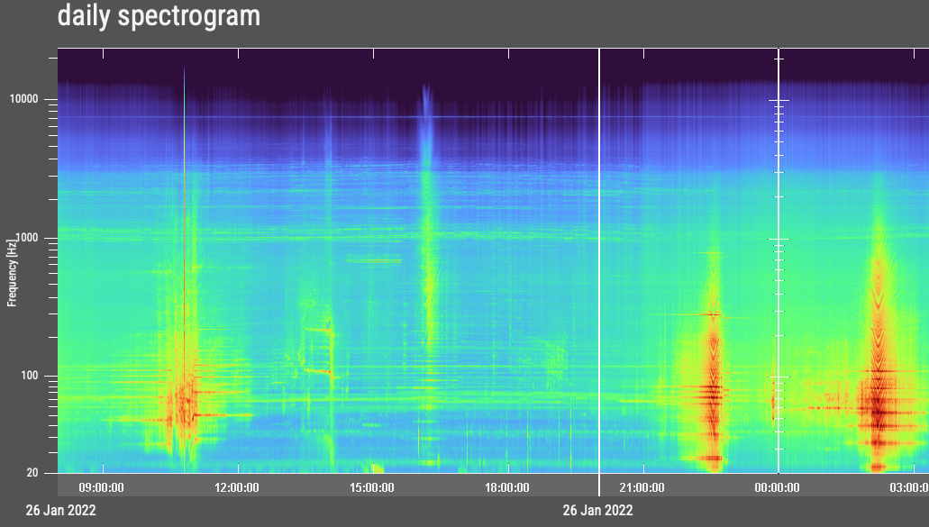
Ocean Sound Data Management Alfred Wegener Institute Open Portal to Underwater Soundscapes

Slide 21
Sound-scape of Kangaroo Island, South Australia
Spectral Probability Density (dB re 1 μPa²/Hz)
Erbe et al. 2016.
Proceedings of Acoustics 1:8-17.
Frequency (Hz)

Slide 22
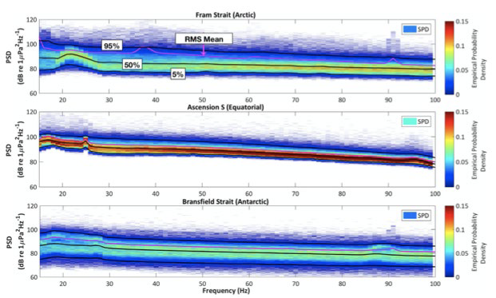
Noise Statistics 15-100 Hz from 2009-2010 show noise at Ascension elevated by airguns
Haver et al. 2017 https://doi.org/10.1016/j.dsr.2017.03.002

Slide 23
Passive Acoustic Monitoring of Effects of Sound on Wildlife: Detection of Echolocation Clicks Shows Beaked Whales Silence During Sonar Exercises
0.45
0.40
0.35
0.30
0.25
0.20
0.15
0.10
0.05
- -
McCarthy et al. 2011 DOI: 10.1111/j.1748-7692.2010.00457.x

Slide 24
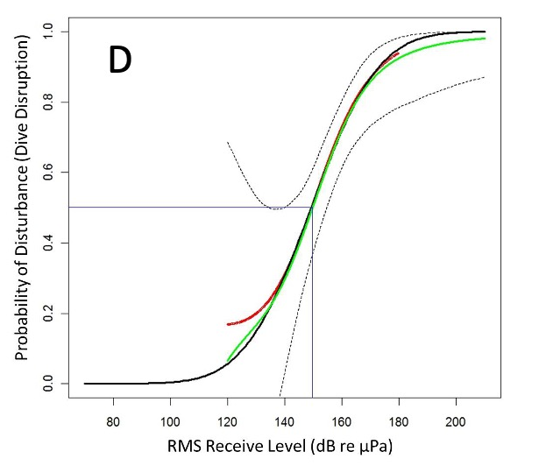
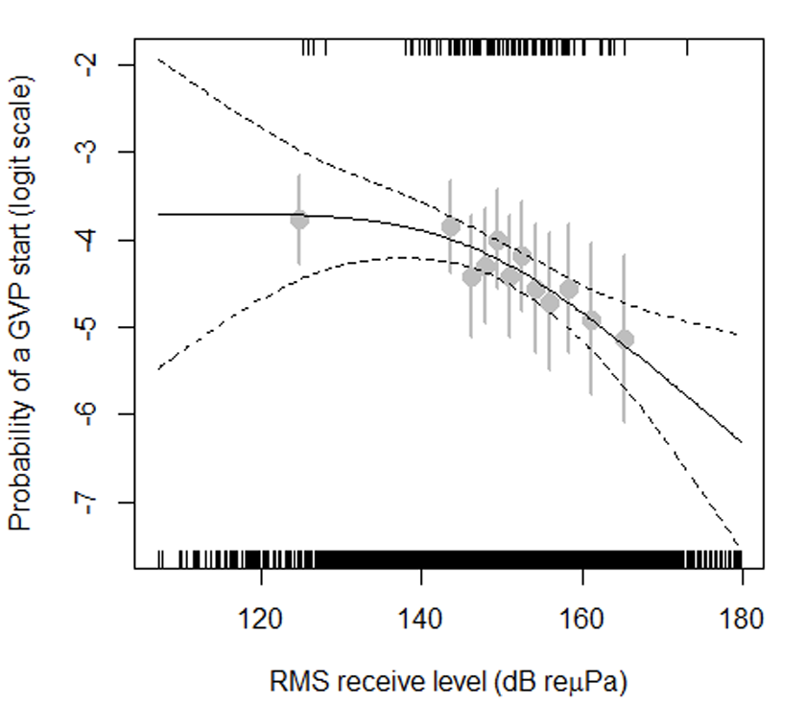
EFFECTS OF ANTHROPOGENIC SOUND: DOSE-RESPONSE FUNCTIONS
Estimating the received level of sonar sound at hydrophones that detected whales vs did not detect whales enables estimation of the probability whales will stop feeding dives as a function of received sonar level
Moretti et al. 2014 PLoS ONE 9(1): e85064. doi:10.1371/journal.pone.0085064

Slide 25
Passive Acoustic Monitoring Can Estimate the Density and Abundance of Vocalizing Animals …
$\hat{\text{Density}}$ = #cues$/\hat{p}$a$\hat{r}$ where p is probability of detecting a cue within area a and r is the call rate to convert #cues to #indiv
Method requires
Detecting calls from various stations or surveys
Estimating the probability of detecting calls as a function of range
Measuring the call rates of different individuals
Marques TA, Thomas L, Martin SW, Mellinger DK, Ward JA, Moretti DJ, Harris D, Tyack PL. 2013. Estimating animal population density using passive acoustics. Biological Reviews 88(2):287-309.

Slide 26
Passive Acoustic Monitoring of Biodiversity
Pros
Persistent and replicable over decadal scales
Long range detection for low frequency sounds
Can discover unknown aggregations (spawning soniferous fish, calling whales)
Different biases compared to other methods
Cons
Few calls can be identified to species; fewer species call at all
Estimating density/abundance requires precise knowledge of sound propagation and calling rates of individuals
Best as a carefully targeted complement to other methods (visual, eDNA, …) to estimate biodiversity

Slide 27
Measuring the Ocean Sound Essential Ocean Variable
Primary GOOS Goals
Climate Change
Wind, Waves, Rain,
Sea Ice
Ocean Health
Marine Ecosystems
Loss of Biodiversity
Impacts on Wildlife
Distribution of Species
Monitoring Threats
Earthquake/Tsunami
Vessels
Other Anthropogenic Sounds
Primary Physical Acoustic Variables
Sound pressure (p,t)
Particle motion (x,y,z,t)
?

Slide 28
Measuring the Ocean Sound EOV
Primary Variables
Sound pressure (p,t)
Particle motion (x,y,z,t)
GOOS Goals
Climate Change
Wind, Waves, Rain,
Sea Ice
Ocean Health
Marine Ecosystems
Loss of Biodiversity
Impacts on Wildlife
Distribution of Species
Monitoring Threats
Earthquake/Tsunami
Vessels
Other Anthropogenic Sounds
Sound Propagation Modeling
Calibration: sensitivity of the hydrophone as a function of frequency and directionality of the receiving system
Geolocation(s) of hydrophone(s)
?
Supporting Variables
Propagation parameters: temperature, salinity,
sound speed profiles, ocean currents and other physical oceanographic phenomena,
boundary conditions (e.g. sea surface roughness, sea ice characteristics (e.g. roughness and thickness), sea floor (bathymetry, geoacoustic properties)
Data
Management
Quality Control
Standardized Analyses
Archive
Sound sources:
non-acoustic information on distribution of sound sources (e.g. ship AIS data); acoustic characteristics of anthropogenic, abiotic and biotic sources
Capacity Building &
Technology Transfer

Slide 29
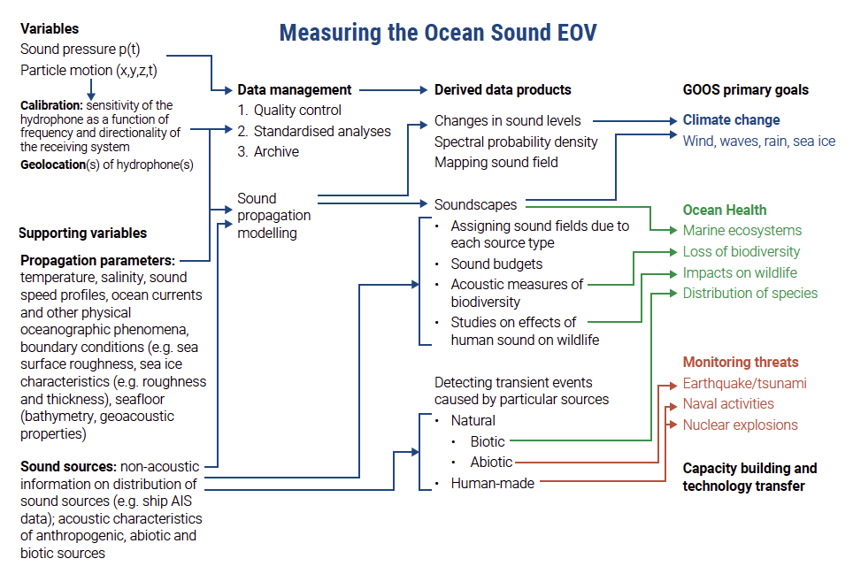

Slide 30
Needs for Collecting, Standardizing, Archiving Open Access Data
Build capacity to improve access to ocean acoustic recording equipment and to design studies and interpret data
Standards for calibrating acoustic measurements are well established, but there is a need for cheap access to calibration facilities
Standards for analyzing noise data
Ocean acoustics generates large data sets. Data may increase in value with age.
Need for cheap sustainable long-term archive set up for open international access

Slide 31
Governance and Funding
Establish a coordination function for an international network of ocean acoustic sensors
Establish QA/QC function for ocean acoustic data and supporting variables
Coordinate and ensure long term sustainability of acoustic data records and derived data products (several strong national efforts underway)
Global capacity building and technology transfer

Slide 32
https://zenodo.org/records/10067187
This document should be cited as: Tyack, P.L., Akamatsu, T., Boebel, O., Chapuis, L., Debusschere, E., de Jong, C., Erbe, C., Evans, K. Gedamke. J., Gridley, T., Haralabus, G., Jenkins, R., Miksis-Olds, J., Sagen, H., Thomsen, F., Thomisch, K., Urban, E. 2023. Ocean Sound Essential Ocean Variable Implementation Plan. International Quiet Ocean Experiment, Scientific Committee on Oceanic Research and Partnership for Observation of the Global Ocean, 87 pp. DOI: 10.5281/zenodo.1006718

Slide 33
Proposed tasks to implement ocean acoustic observations for GOOS
Set up international coordination for observations from hydrophones and particle motion detectors
Maintain the existing global set of hydrophones and particle motion detectors and historic ocean sound datasets
Foster inclusion of particle motion sensors and their deployment systems where needed
Review existing deployments of ocean acoustic sensors, identify gaps in coverage and propose how to mature them into a GOOS observation network
Develop standards for GOOS-compatible underwater acoustic recording systems and explore adding acoustic sensors to existing GOOS networks
Establish working group(s) on calibration, standardizing data analysis, and data management
Develop standardized open-access databases of ocean sound produced by known human, biotic, and abiotic sources
Develop low-cost underwater acoustic measurement and recording systems for educational and citizen science applications
Engage with industry and regulators along with ocean acoustic modelers to develop hindcast, nowcast and forecast ocean soundscape scenarios
Reach out to policymakers, industry representatives, the media, and other stakeholders
Develop a self-sustaining observation network for the Ocean Sound EOV

Slide 34
Acoustic Measurement of Ocean Biodiversity
The primary IQOE effort on this is
Mooney, T.A., L. Di Iorio, M. Lammers, T-H. Lin, S. Nedelec, M. Parsons, C. Radford, E. Urban, and J. Stanley. 2020 Listening forward: approaching marine biodiversity assessments using acoustic methods. R. Soc. Open Sci. 7:201287. http://dx.doi.org/10.1098/rsos.201287
Who state the following points:
Conventional marine survey methods, such as visual and photographic/video surveys, are largely adapted from traditional terrestrial methods, yet they allow for only intermittent assessments of biodiversity and are only achievable when sites can be accessed (due to weather, depth and remoteness) and conditions are amenable to visual observation
Acoustic diversity metrics: when species’ acoustic signals have distinct characteristics, such as frequency ( pitch), amplitude, duration and repetition rate, this specificity can allow for discrimination of species, sex and behaviours.
Some terrestrial studies suggest soundscape complexity increases with species richness
But “no clear methods seem successful to extract biodiversity data from marine acoustic recordings, and applications of even an array of (terrestrial) acoustic diversity indices seem ineffective”

Slide 35
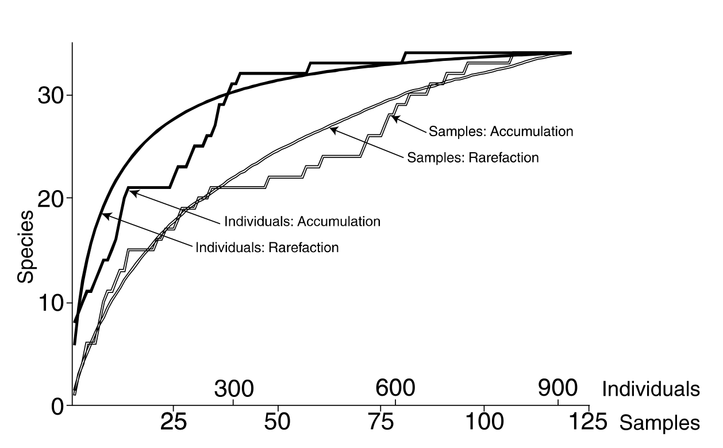
Most Biodiversity Indices Require # Indiv of Each Species
Name | Formula | Nindiv | Nsp
Species Richness | Nsp |  | x
Biodiversity | Nindiv/Nsp | x | x
Shannon’s | $\sum{p_{i}}$ln($p_{i}$) where p is proportion of i^{th} species | x | x
Simpson’s | 1-$\sum{({Nindiv}_{i}}$N)² where Nindiv_{i} = # indiv of species i and N=total #indiv | x | x

Slide 36
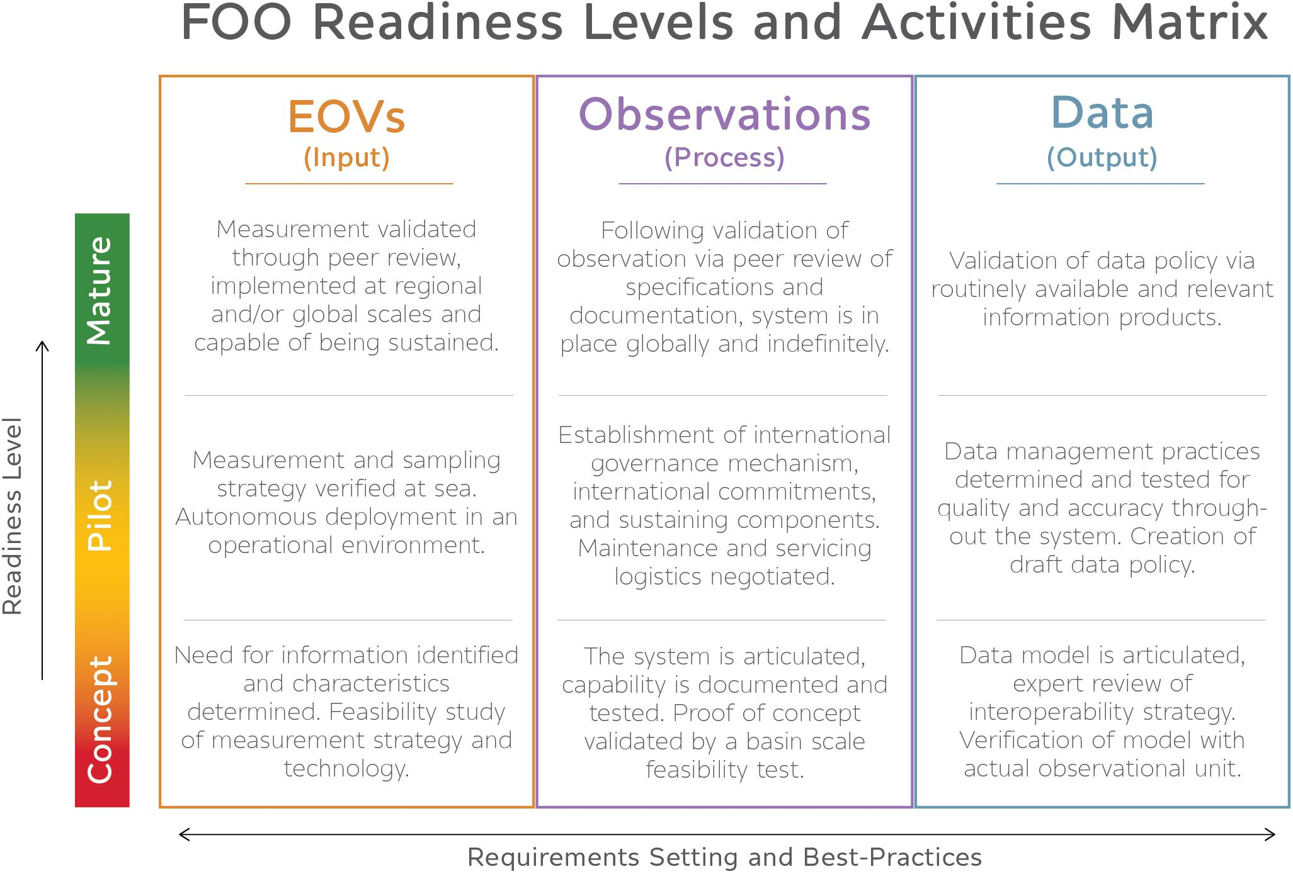

Slide 37
Implementation Issues
How do we engage all of the ocean acoustics communities?
Ocean acoustics
Fisheries Acoustics
Marine bioacoustics
How do we organize our multi-disciplinary approach for sustained funding of ocean acoustic measurements?
What are the highest priorities for a global network that measures ocean sound ?
Request: Please contact ed.urban@scor-int.org about any underwater acoustic recording stations maintained by your institution

Slide 38
Ocean Acoustic Standards
IQOE Inventory of Existing Standards for Observations of sound in the ocean (https://www.iqoe.org/sites/default/files/files/IQOE%20Inventory%20of%20existing%20standards%20-%20Version%202018-04-06.pdf)
Workshop Report: Guidelines for Observation of Ocean Sound (https://scorint.org/IQOE/IQOE_2019_Standards_Workshop_Report.pdf)
IQOE Inventory of existing standards and guidelines relevant to marine bioacoustics (https://scor-int.org/wp-content/uploads/2021/06/IQOE-Inventory-of-existing-standards-in-bioacoustics-20210625.pdf)

