Slide 1
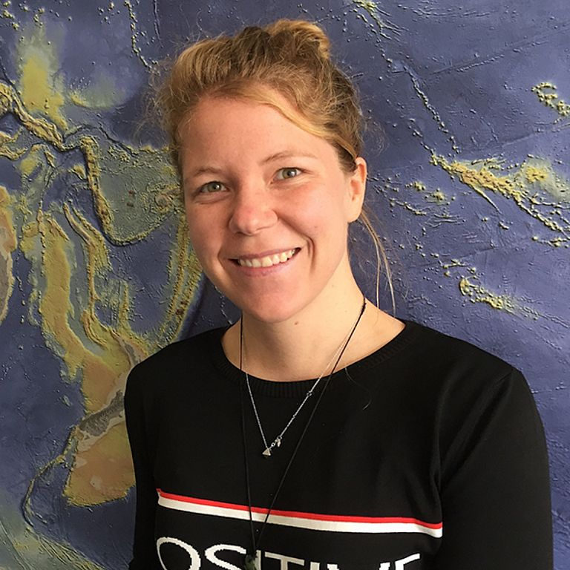
Experiences from EMB Young Ambassadors:
Connecting research with marine policy and society
Dr Rebecca Zitoun
Marine Mineral Resources Group
GEOMAR Helmholtz Centre for Ocean Research Kiel
rzitoun@geomar.de
EMB Science Webinar - 16 March 2023
Notes:
1

Slide 2
SCIENCE-SOCIETY-POLICY
„THE OCEAN WE NEED FOR THE FUTURE WE WANT“
SOCIETY
Government-Society Interface
FUNDING
&
POLICIES
Science-Society Interface
GOVERNMENT
SCIENCE
Science-Government Interface
EMB Science Webinar - 16 March 2023

Slide 3
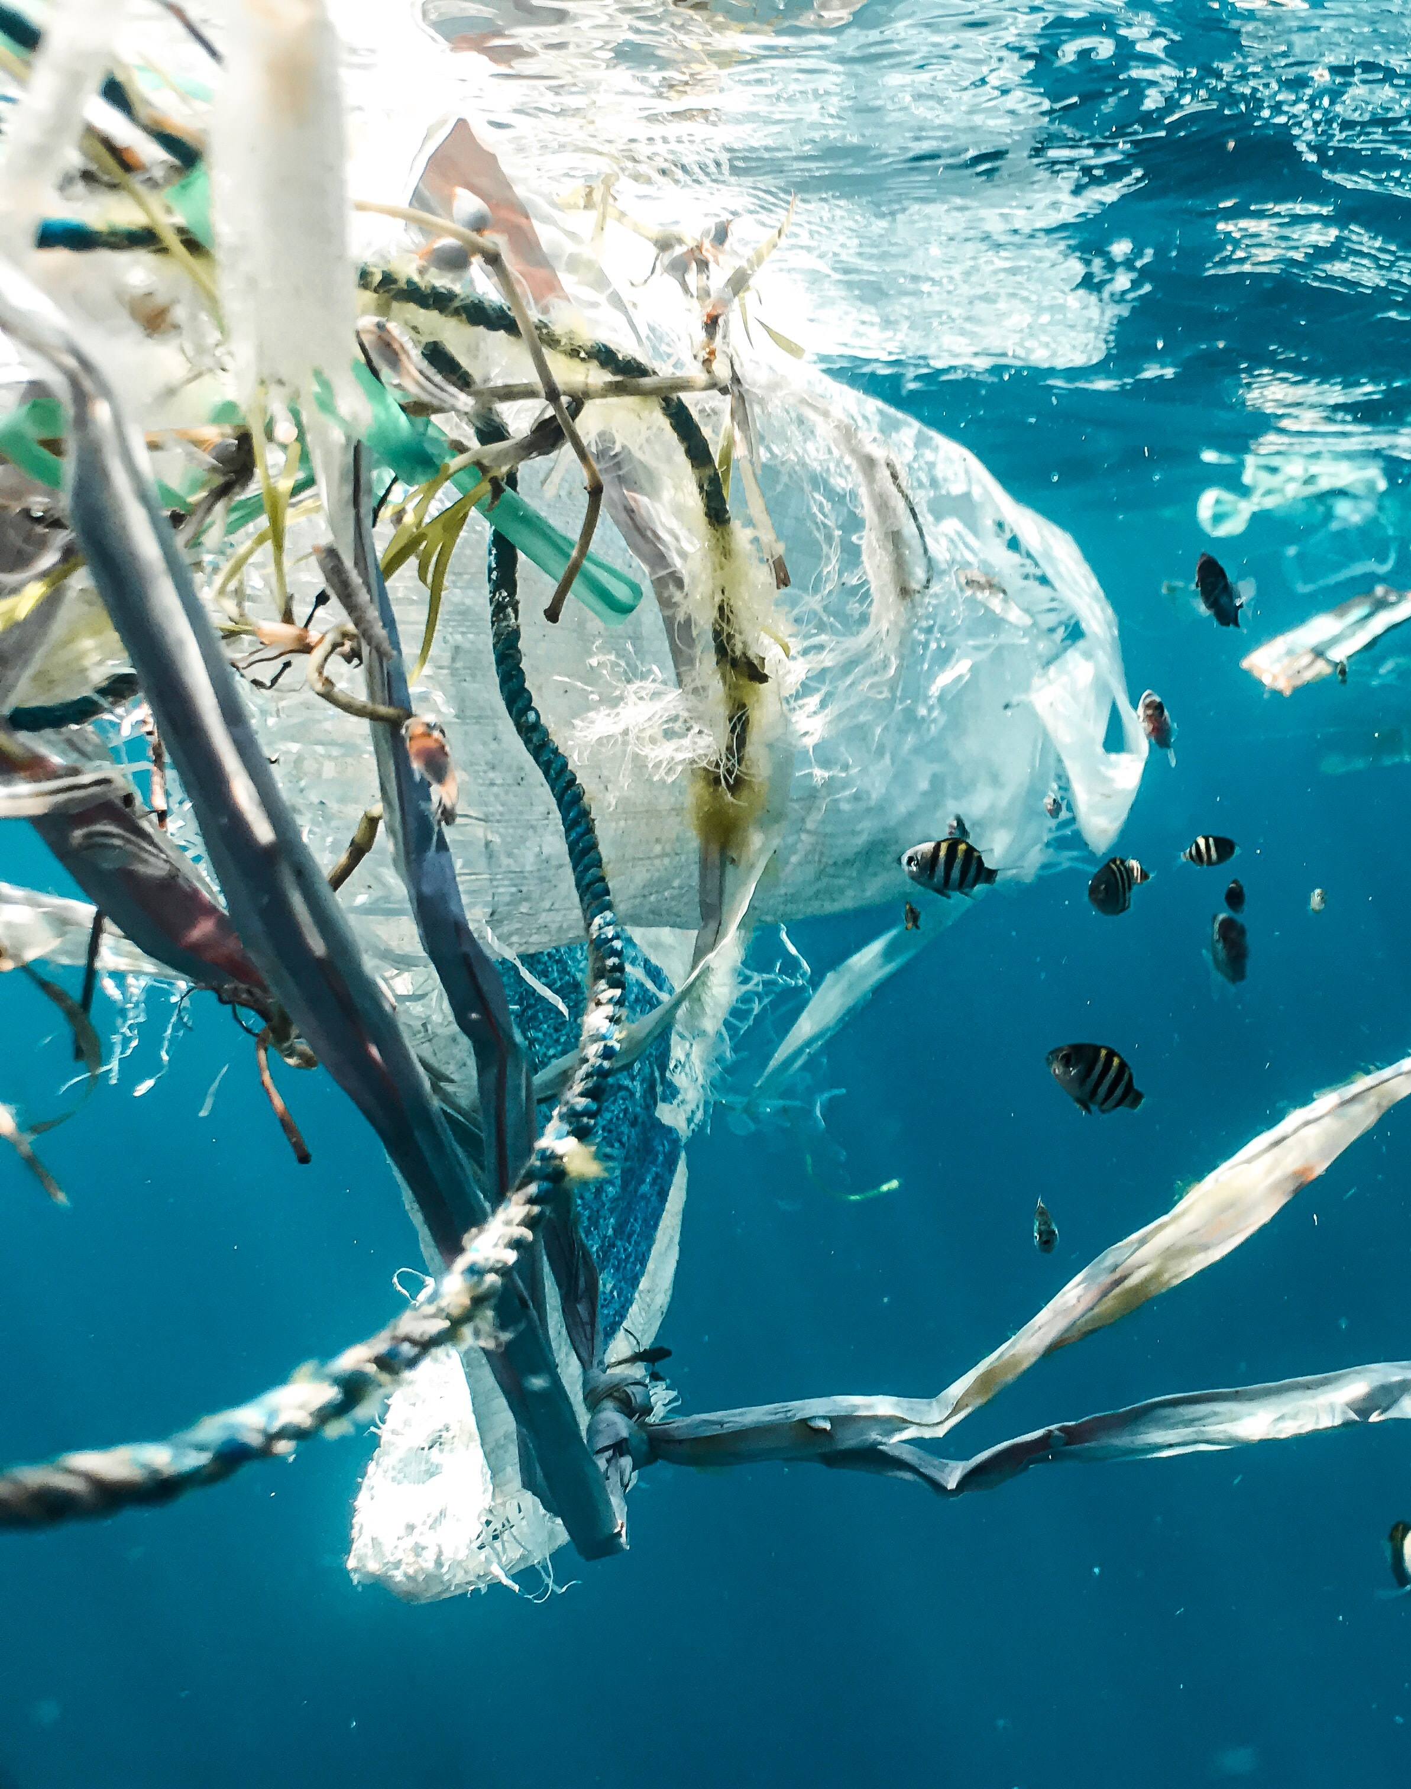
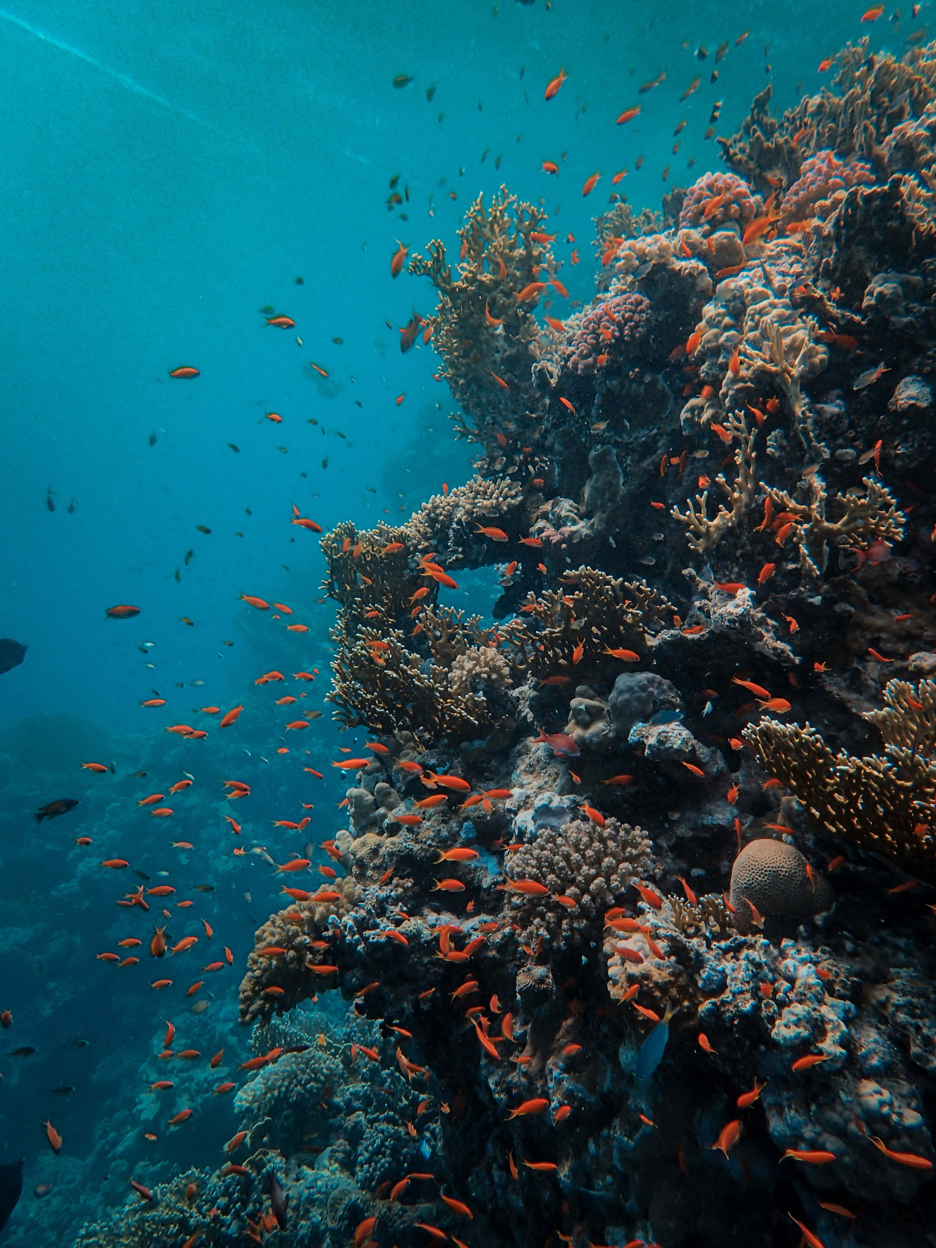
SCIENCE-SOCIETY-POLICY
Ocean Literacy
Science Communication
Engagement
THE OCEAN WE HAVE
THE OCEAN WE NEED
EMB Science Webinar - 16 March 2023

Slide 4
OCEAN LITERACY
Definition: “an understanding of the ocean's influence on you and your influence on the ocean”.
SCHOOLS
CITIZEN
DECISION MAKERS & ENTREPRENEURS
Source: https://virtue.gmbl.se/de

Slide 5

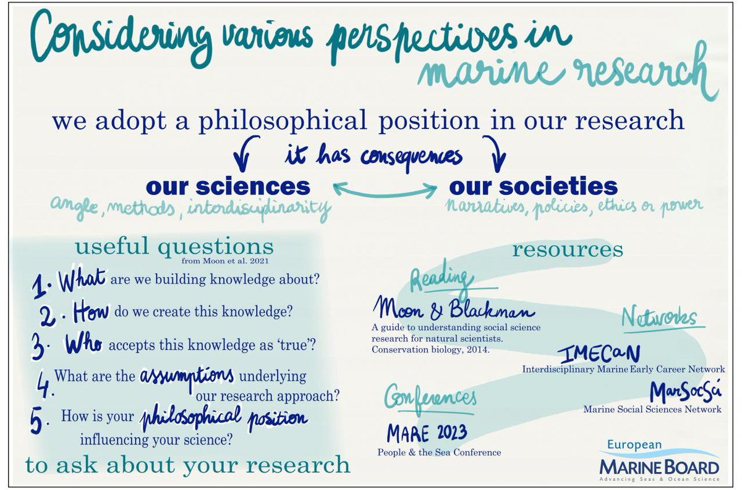
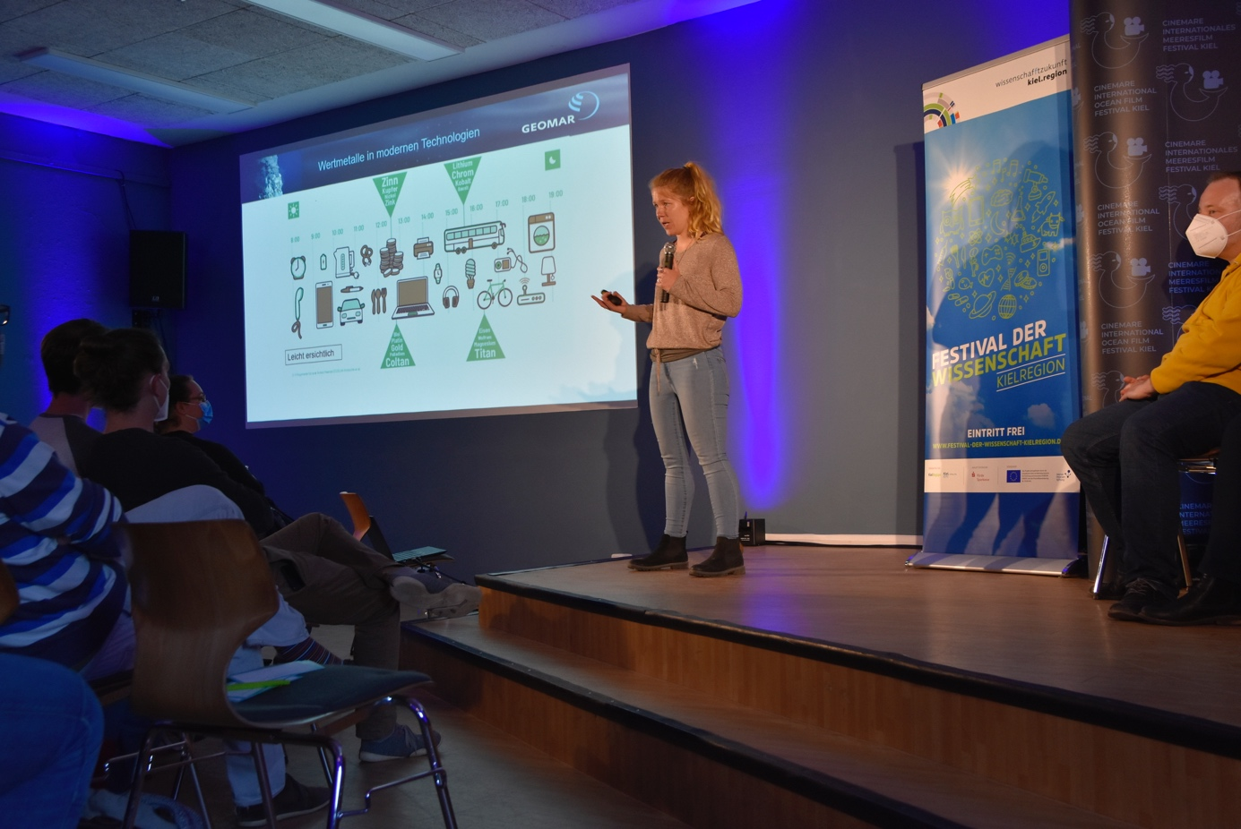
OCEAN LITERACY
ENGANGING, INFORMING, EDUCATING
What you can do:
Develop resources
Promote innovative ocean data visualization tools
Participate/facilitate events
Engage with the local community
„For in the end, we will only conserve what we love. We will only love what we understand. We will only understand what we are taught“ – Baba Dioum
Notes:
.

Slide 6
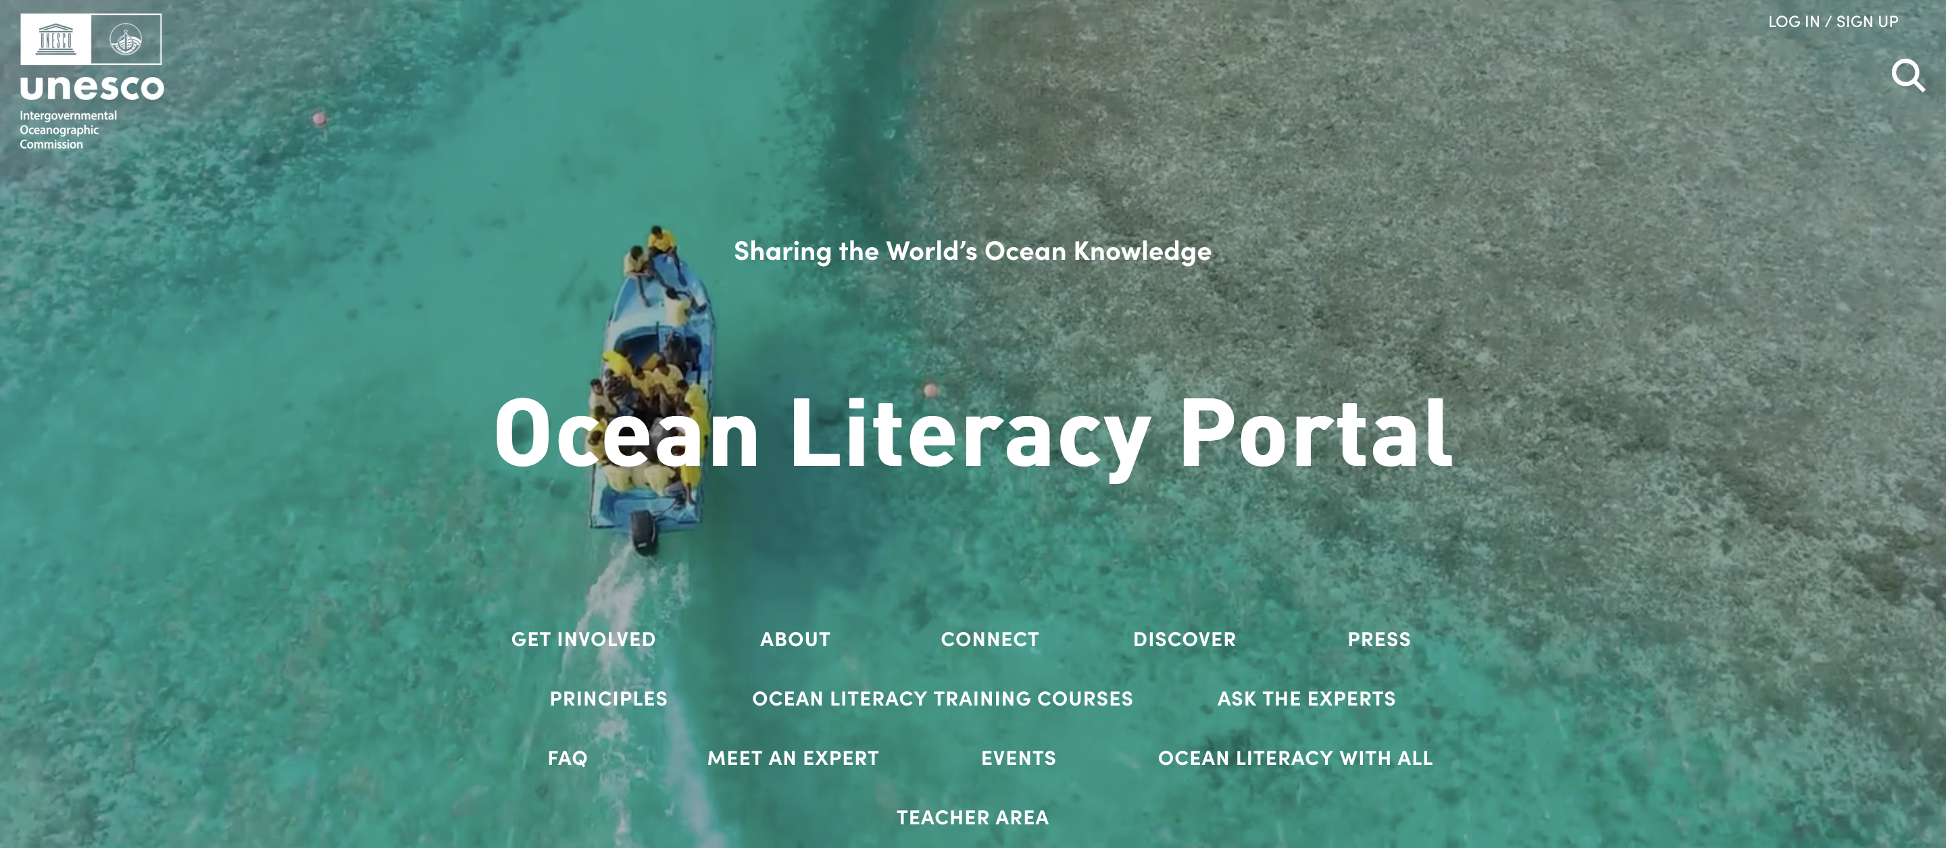
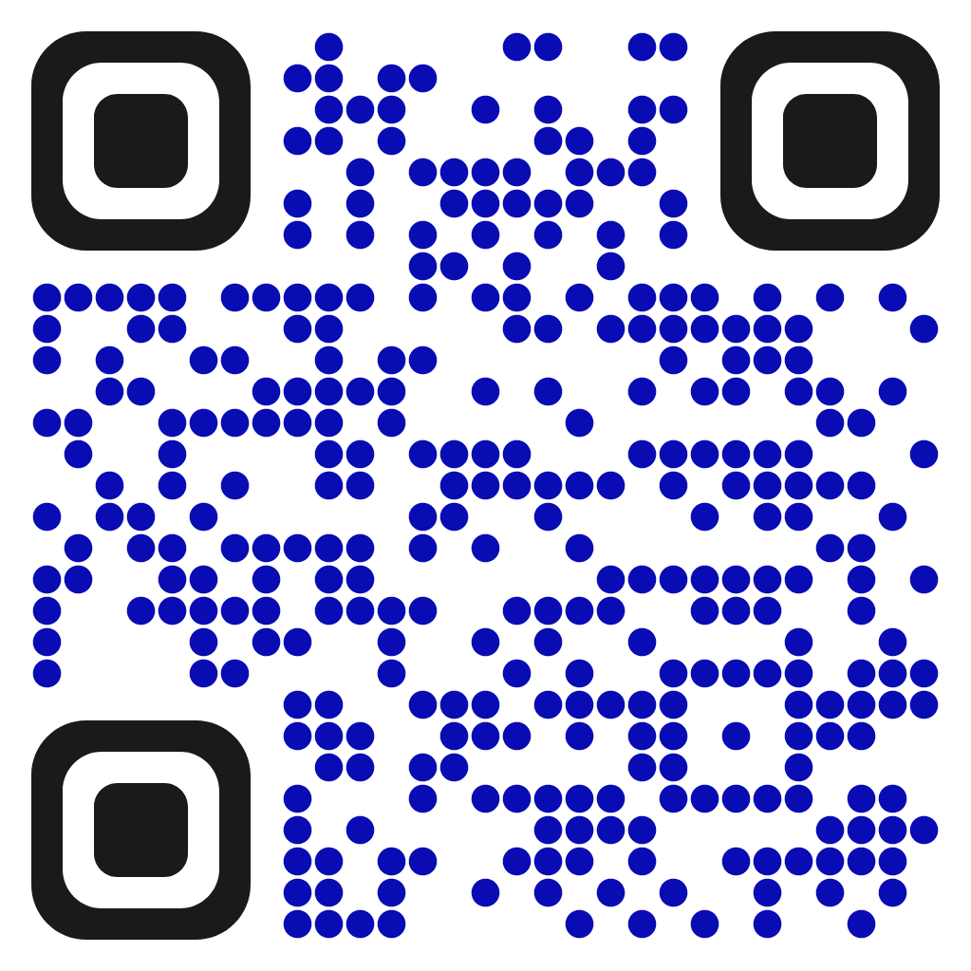
OCEAN LITERACY
EMB Science Webinar - 16 March 2023

Slide 7

SCIENCE COMMUNICATION
OUTREACH
SCIENCE COMMUNICATION
STORYTELLING
“In short, [the soul of science communication] is about making people care. That is why we need to go beyond presenting facts and evidence, towards creating emotional connections between scientists and publics“ - Journal of Science Communication
Source: Kopke et al., 2019
Source: Tom Dunne
EMB Science Webinar - 16 March 2023

Slide 8
SCIENCE COMMUNICATION
EMB Science Webinar - 16 March 2023

Slide 9
SCIENCE COMMUNICATION
BOOKS
EMB Science Webinar - 16 March 2023

Slide 10
ENGAGEMENT
PARTICIPATORY APPROACH
Co-design and Co-development
Speaking common language
Finding common denominator
Building ownership and trust
PURPOSE AND TARGET
DRIVEN SCIENCE
Source: Dinseh et al., 2018
EMB Science Webinar - 16 March 2023

Slide 11
ENGAGEMENT
Future Science Briefs
Policy Briefs
EMB Science Webinar - 16 March 2023

Slide 12
ENGAGEMENT
Science-Policy Webinars
ECOP Webinars
20 April 2023: EMBracing the Ocean artists-in-residence: Enabling Ocean sustainability through creative collaboration
5 April 2023: Deep sea mining and conservation
EMB Science Webinar - 16 March 2023

Slide 13
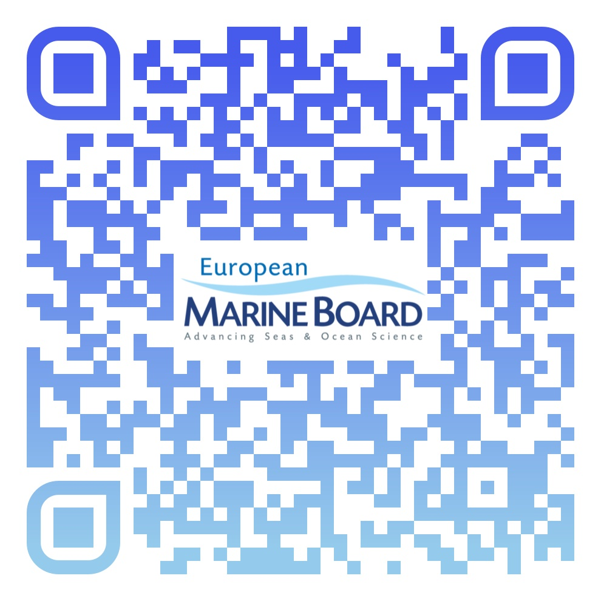
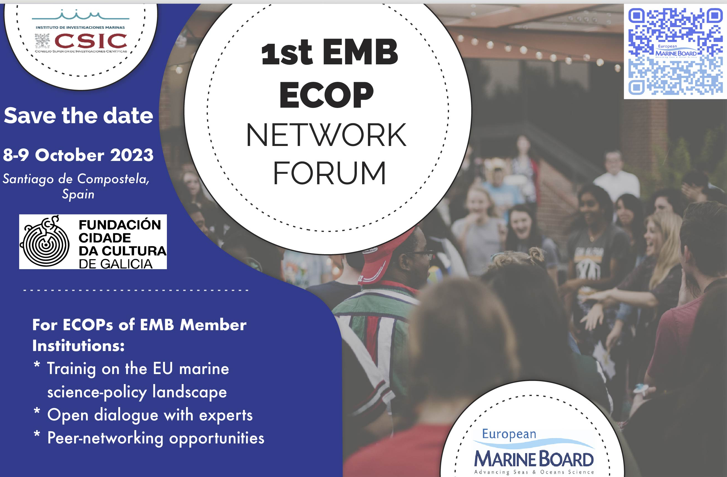
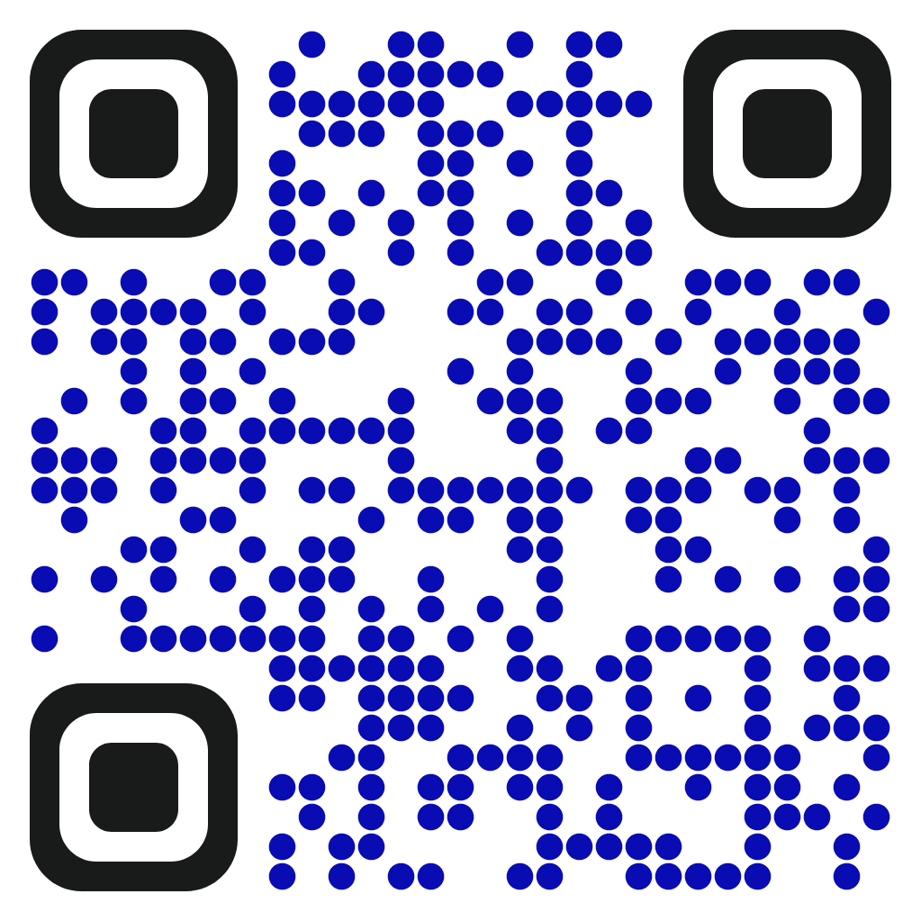
ENGAGEMENT
Science-Policy Conference
Science-Policy ECOP Training
Provides a forum for the marine and maritime research community and wider stakeholders to interface with European and Member State policymakers and strategic planners.
This Forum will offer EMB ECOPs an important networking opportunity, as well as training in marine policies and communication.
EMB Science Webinar - 16 March 2023

Slide 14
CONNECTING WITH POLICY AND SOCIETY
OCEAN LITERACY
Importance of engaging, informing, and educating every level of society
SCIENCE COMMUNICATION
Importance of using narratives and storytelling to communicate science
ENGAGEMENT
Importance of co-designing and co-developing projects to conduct purpuse and target driven science

Slide 15

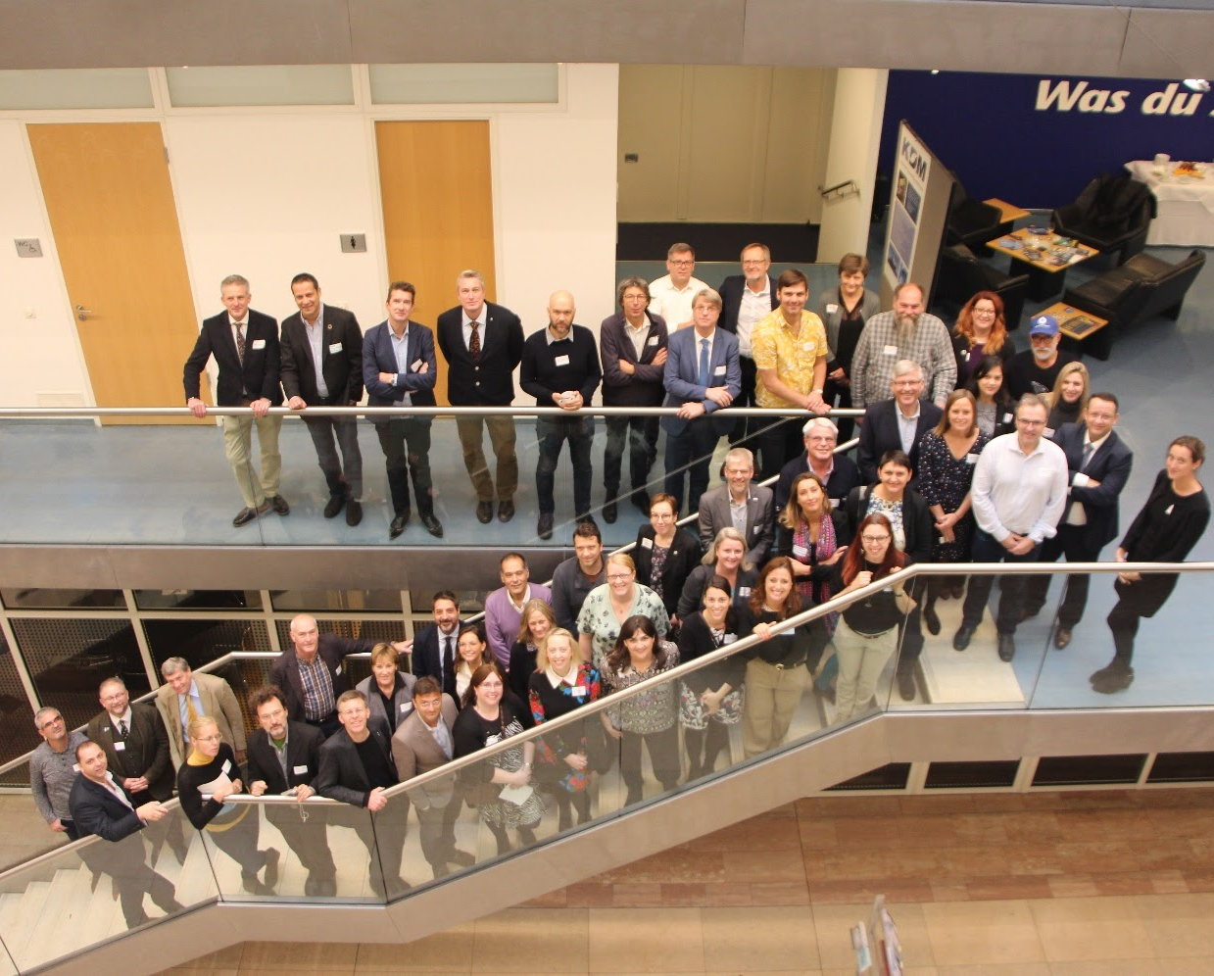



THANK YOU FOR
YOUR
ATTENTION
info@marineboard.eu
http://www.marineboard.eu/
@EMarineBoard
Rebecca Zitoun
Marine Mineral Resources
rzitoun@geomar.de
Notes:
15

