Slide 1
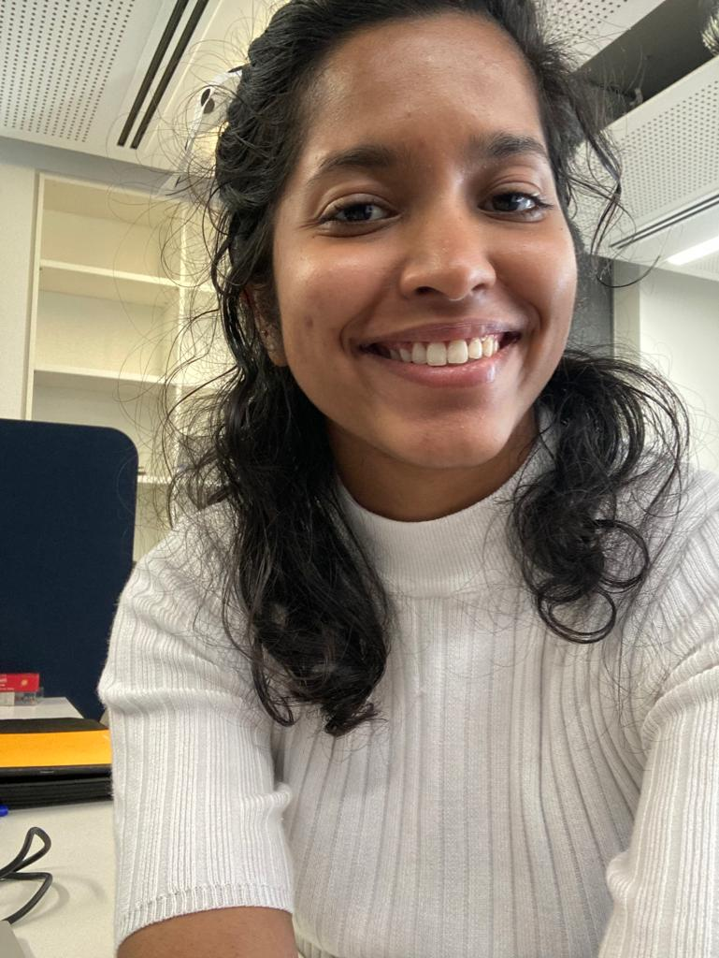
Experiences from EMB Young Ambassadors: Lessons and Introspections from an ECOP’s perspective
Anjali Gopakumar
EMB Young Ambassador, 2021- 2023

Slide 2
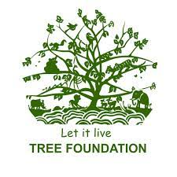
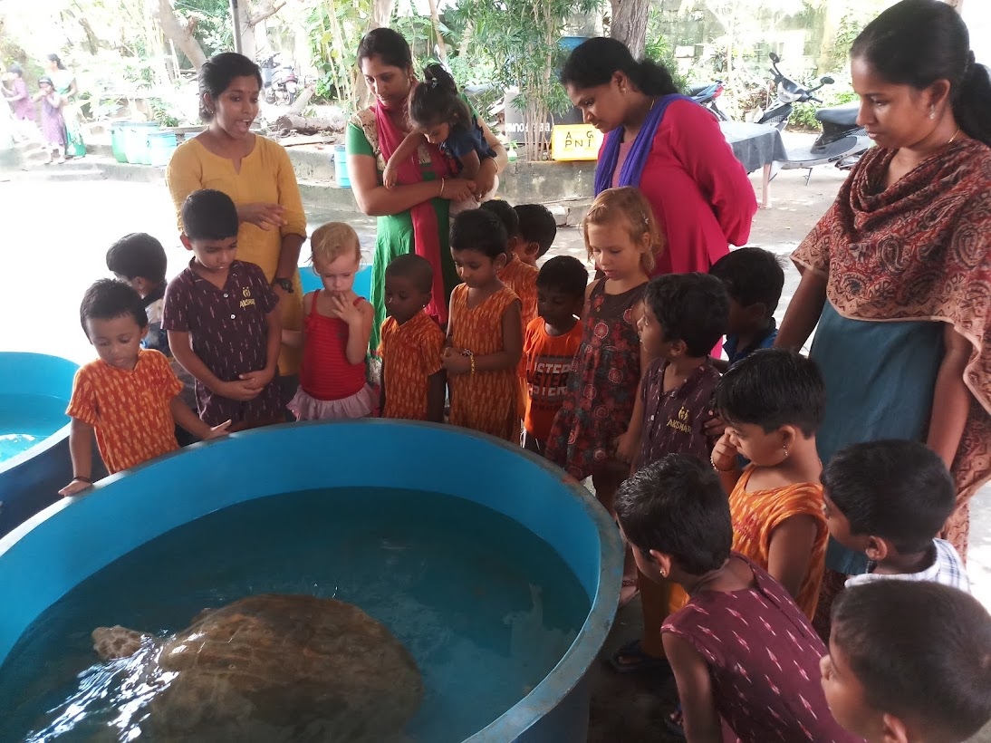
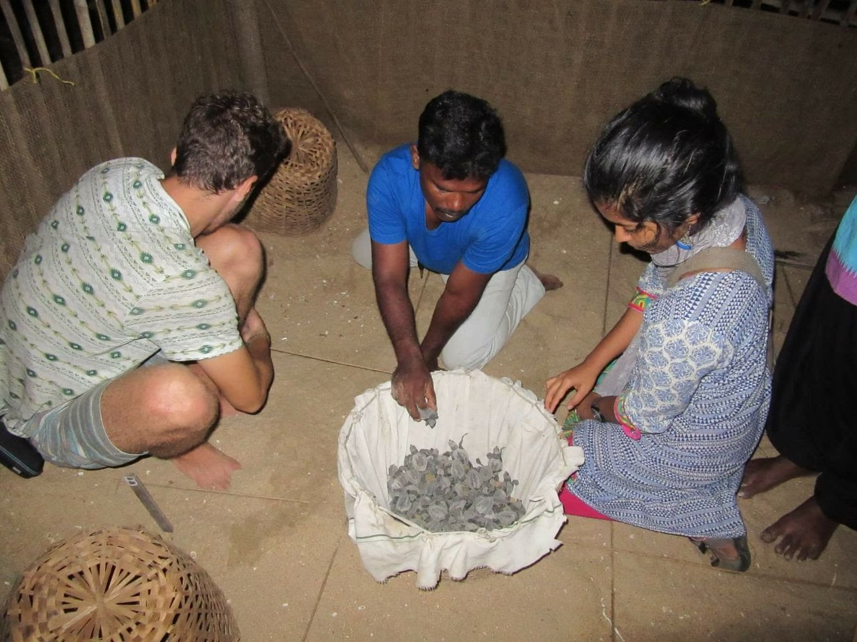
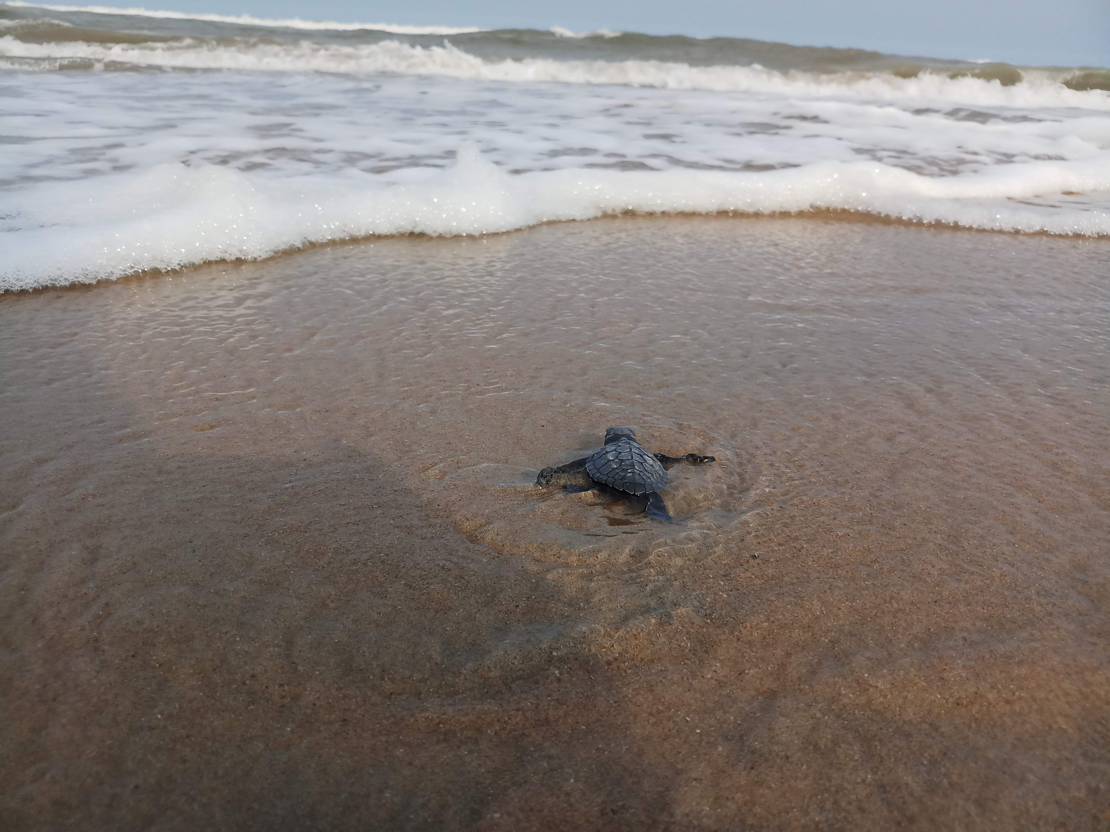
Part 1: A look into my background and PhD work
B.Tech in Biotechnology VIT University, Vellore, India
Programme Coordinator TREE Foundation, India

Slide 3
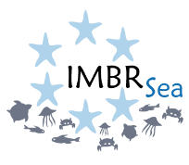
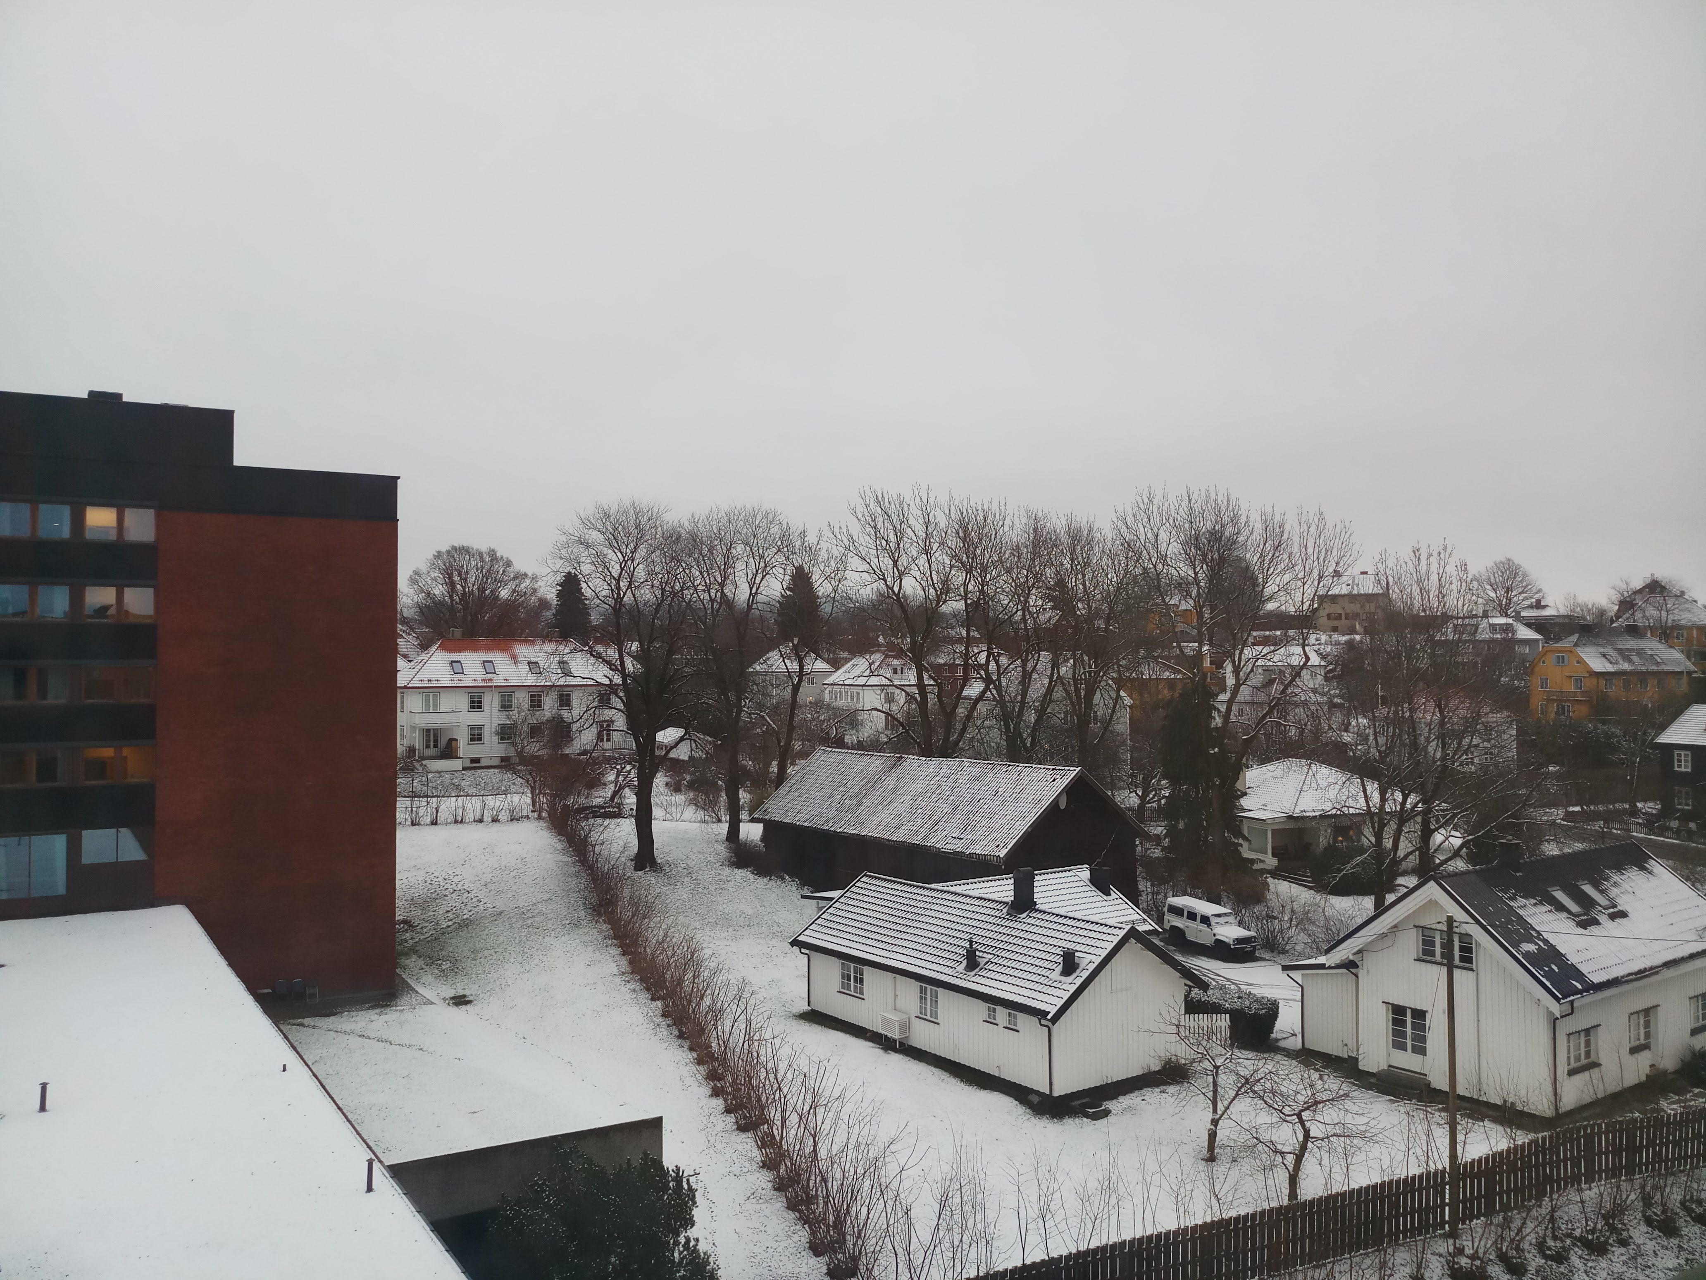
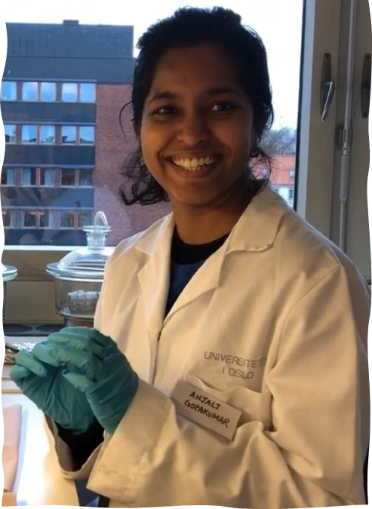
International Master of Science in Marine Biological Resources (IMBRSea) -EU Funded Erasmus Mundus Joint Master Degree
University of Oviedo (Spain)
Universitá Politecnica della Marche (Italy)
Sorbonne Université (France)
University of Oslo (Norway)
“Mercury Accumulation in fishes from North-East and North-West Barents Sea during the polar night”

Slide 4
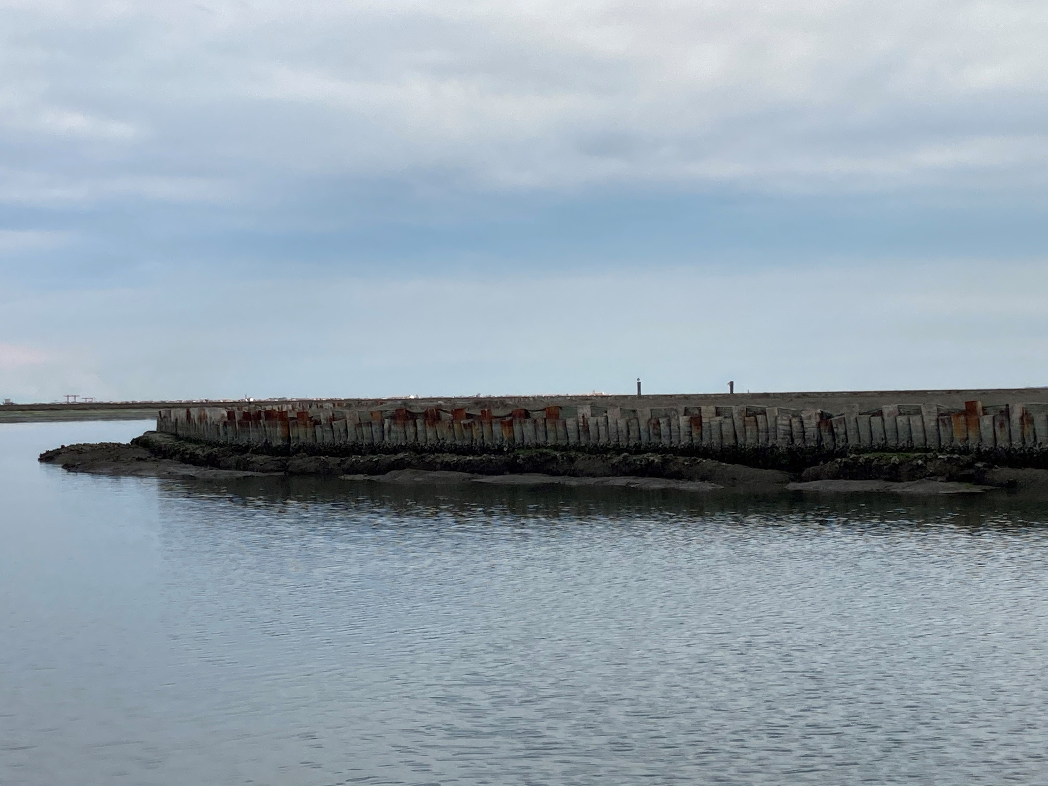
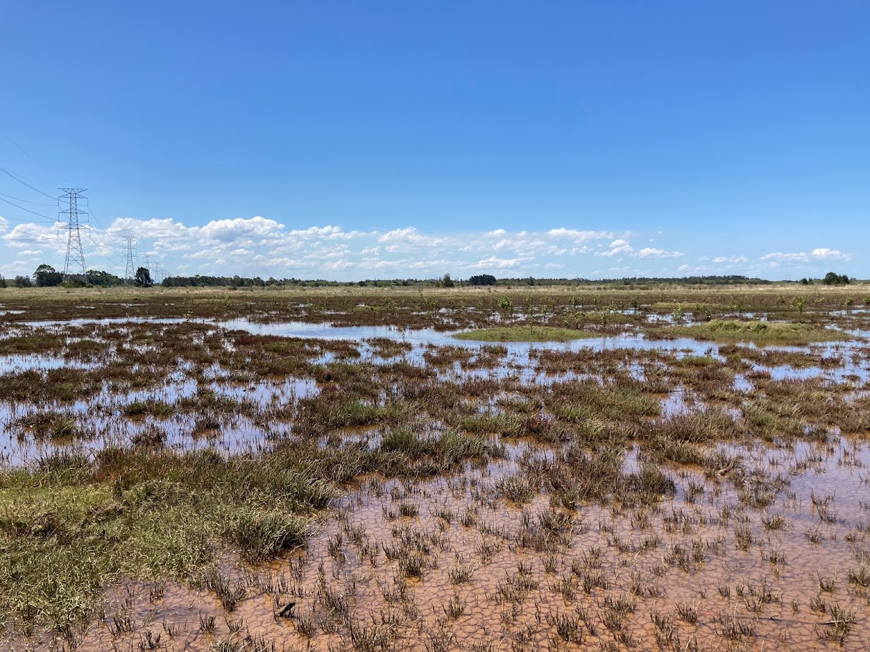
Cotutelle PhD in Marine Ecology
University of Bologna (Italy)/ Macquarie University (Australia)
“Ecosystem Functions and Services of Restored Saltmarshes in Urban Seascapes”
Supervisors: Prof. Laura Airoldi and Dr. Katherine Dafforn
Overall Aim: To assess restoration outcomes at the microbial scale, in coastal salt marsh ecosystems

Slide 5
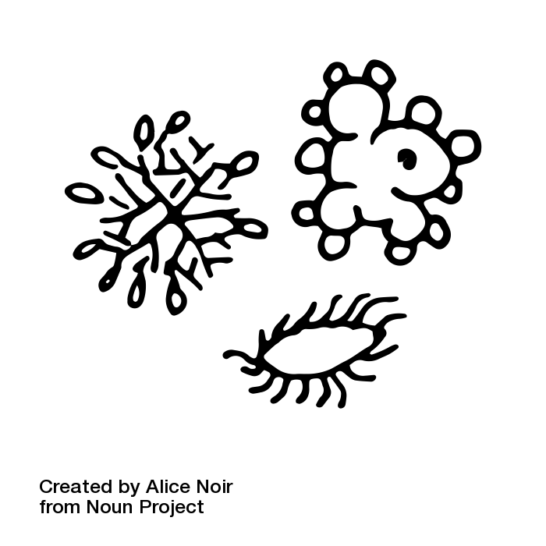
Objectives of my PhD
Assess effect of restoration on sediment microbial communities in salt marshes.

Slide 6
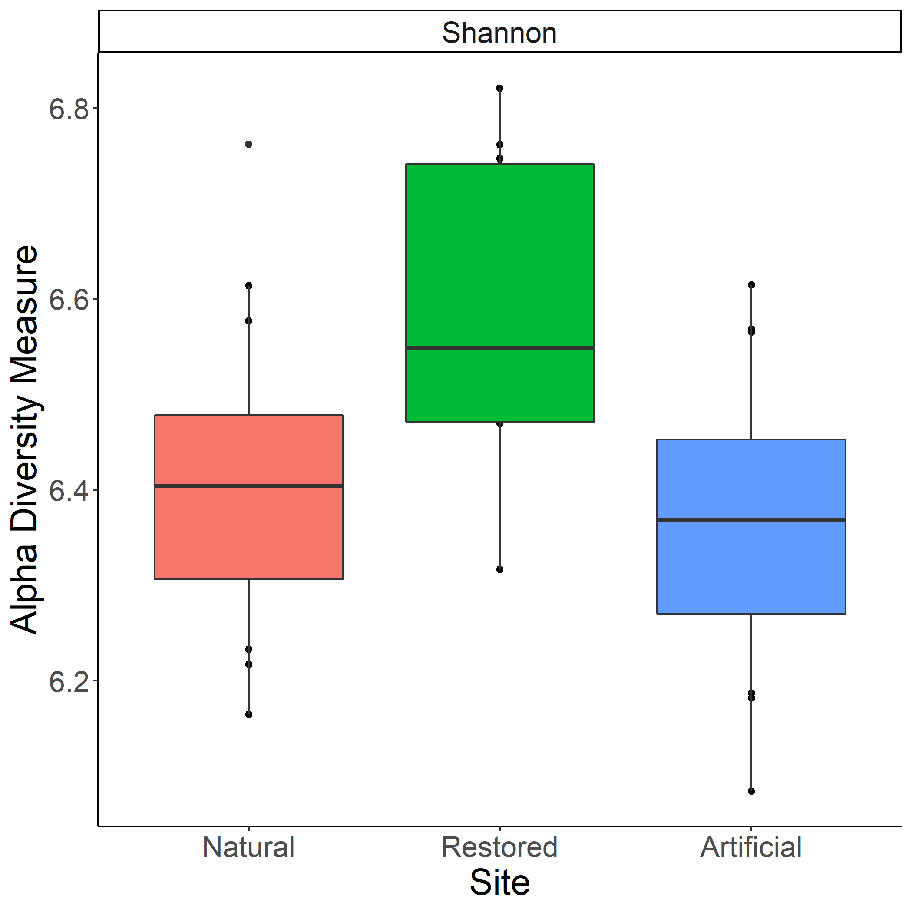
Objectives of my PhD
Assess effect of restoration on sediment microbial communities in salt marshes.
Change in the microbial community structure and function between natural and restored saltmarshes in Venice lagoon
Physically restored saltmarshes improve microbial diversity along saltmarsh edge, than natural and artificially constructed ones.

Slide 7
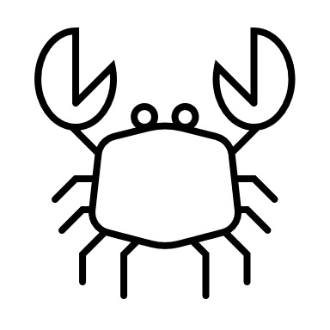
Objectives of my PhD
Assess effect of restoration on sediment microbial communities in salt marshes.
Assess effect of restoration on benthic functional diversity in salt marshes.

Slide 8
Objectives of my PhD
Assess effect of restoration on benthic functional diversity in salt marshes.
Natural
Restored
Artificial
Change in the benthic functional groups between natural and restored saltmarshes in Venice lagoon

Slide 9
Objectives of my PhD
Assess effect of restoration on sediment microbial communities in salt marshes.
Assess effect of restoration on benthic functional diversity in salt marshes.
Assess effect of restoration on biogeochemical functioning in salt marshes.
H₂S
H₂S
N₂O
N₂O

Slide 10
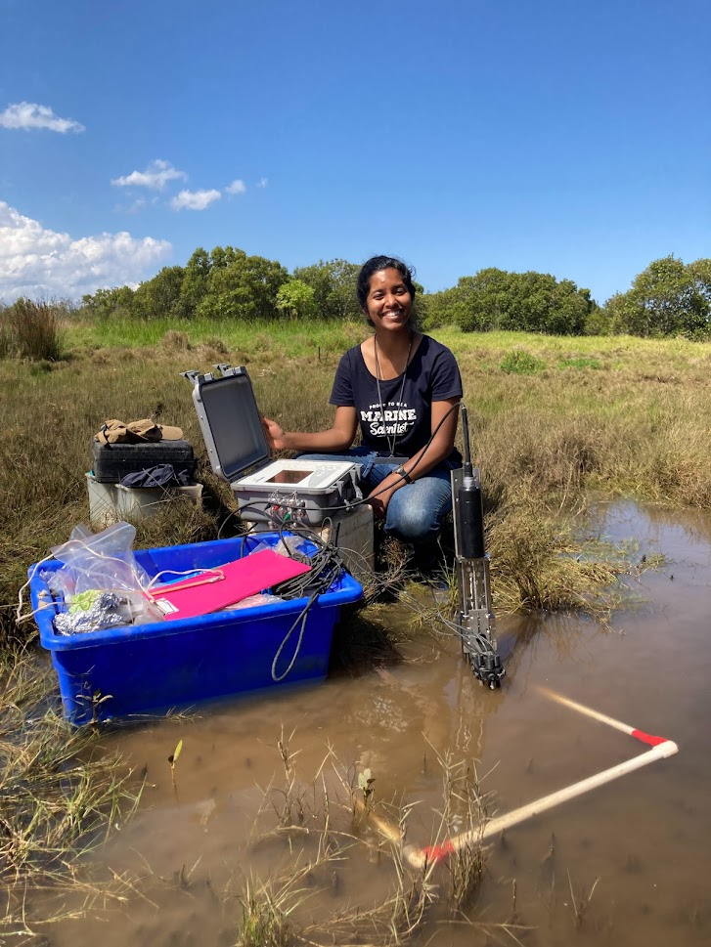
Objectives of my PhD
Assess effect of restoration on biogeochemical functioning in salt marshes.
H₂S
N₂O
Change in biogeochemical fluxes over different restoration stages
Change in microbial community structure over different restoration stages

Slide 11
Objectives of my PhD
Assess effect of restoration on sediment microbial communities in salt marshes.
Assess effect of restoration on benthic functional diversity in salt marshes.
Assess effect of restoration on biogeochemical functioning in salt marshes.
Assess effect of restoration on decomposition rates in salt marshes.
H₂S
N₂O
N₂O

Slide 12
Objectives of my PhD
Assess effect of restoration on decomposition rates in salt marshes.
Change in decomposition rates between natural and restored saltmarshes
Change in microbial community structure between natural and restored saltmarshes

Slide 13
Part 2: EMB Young Ambassadorship
EMB Young Ambassador (2021-2023)
Promote and raise awareness about ocean science and marine policies to the general public
Organise workshops and forums to engage and network with early career ocean professionals
Present science and policy-related activities at universities and lab meetings
Write blog articles on various topics concerning early career ocean professionals and marine policies

Slide 14
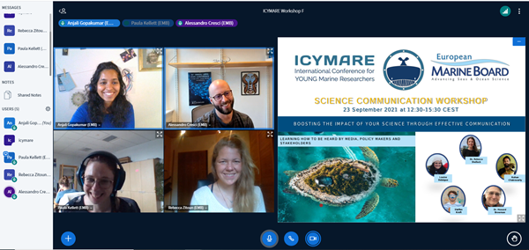
ICYMARE Workshop on Science Communication

Slide 15
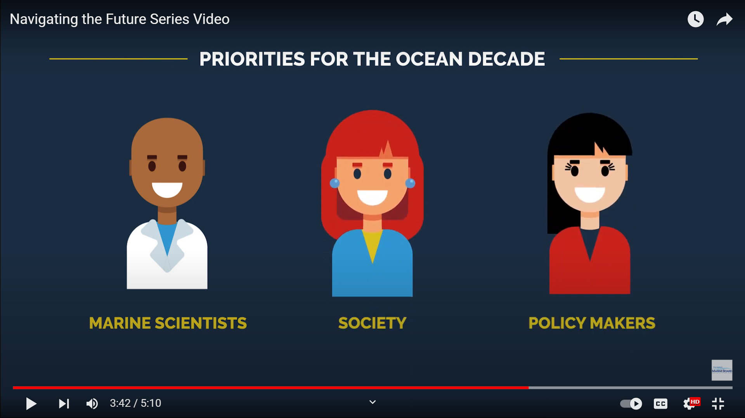
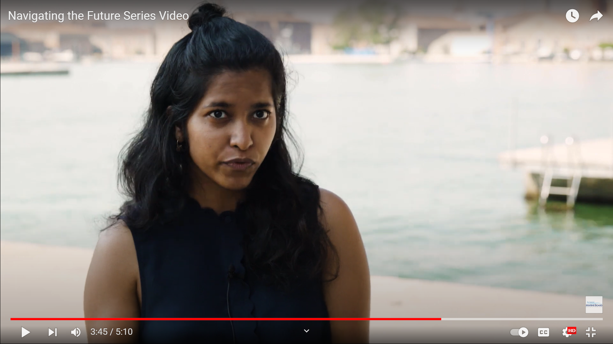
Participating in the Navigating the Future V Video Series

Slide 16
8th EMB Forum on Supporting the Ocean Decade in Europe

Slide 17
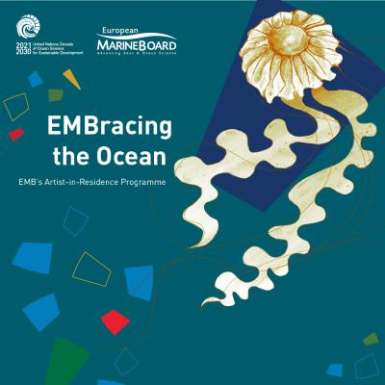
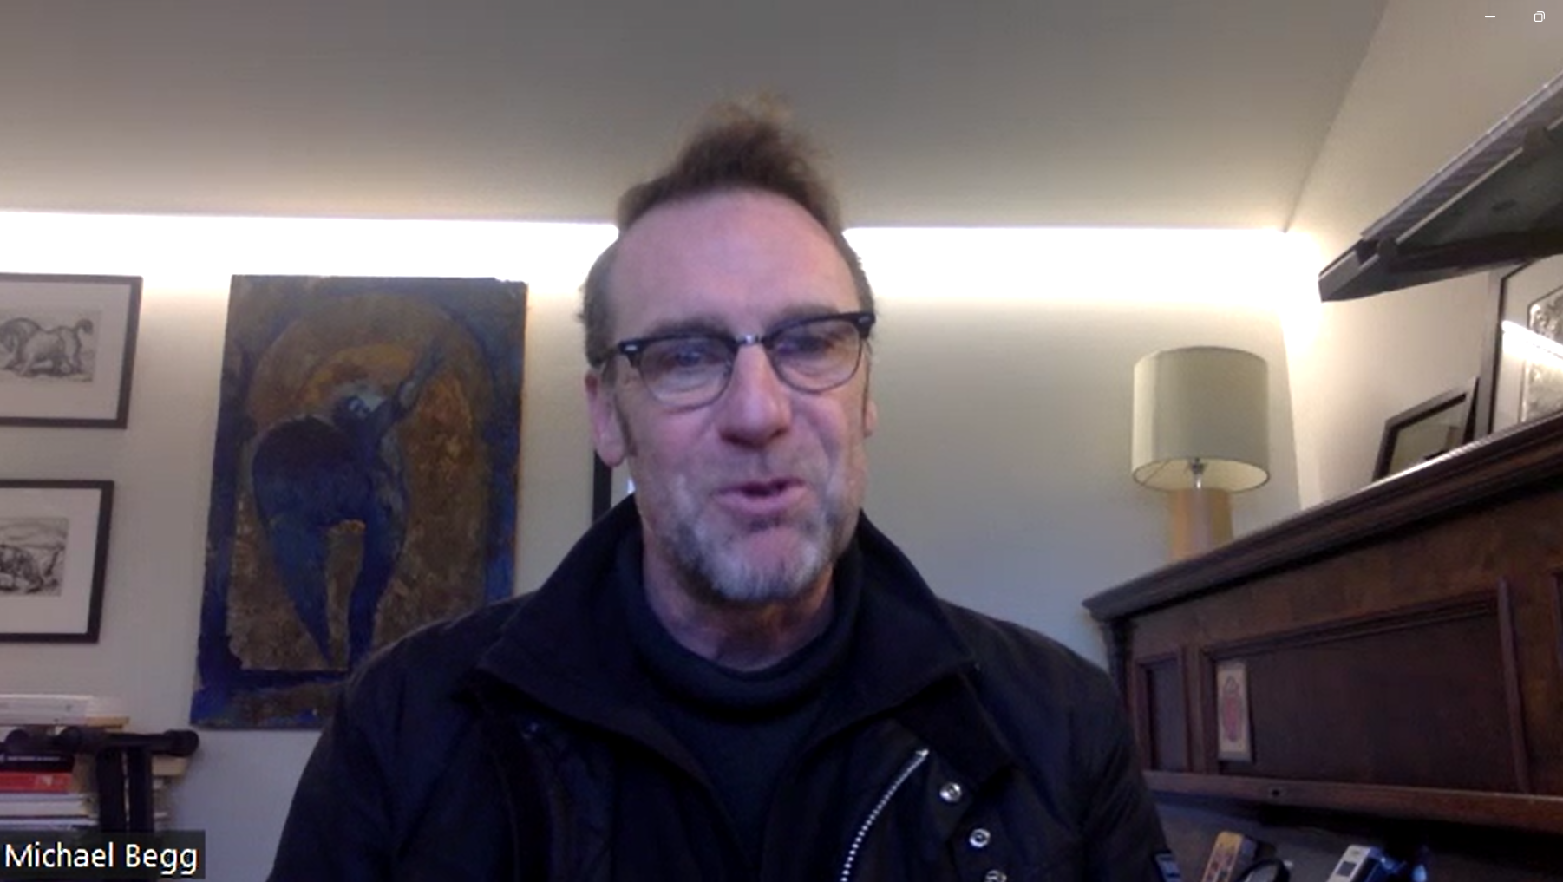
Interviewing the artists from EMB’s EMBracing the Ocean Artist-in-Residence programme programme

Slide 18
Part 3: Managing commitments- ECOP’s perspective
Finding my footing
Lessons and Tools
What would I have changed?
Could not have done much differently, but would have been more accepting of myself and my limits
Notes:
-Move to Australia- came with its own set of challenges- navigating a new university, new rules, new lab group etc while continuing to do your phd
- New sets of admin, repeat of study site selection, inductions etc
- Time difference- EMB has been extremely accommodating of the time zone differences, but it still was a challenge to be focused after a full day of work

Slide 19
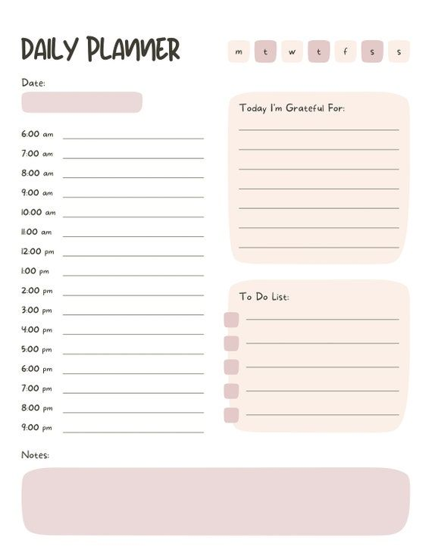
Part 3: Managing commitments- ECOP’s perspective
Time Management
Lessons and Tools
What would I have changed?
PRIORITIZE!
Dedicated time for EMB emails
Dedicated specific time and days for EMB focused work
Notes:
-Move to Australia- came with its own set of challenges- navigating a new university, new rules, new lab group etc while continuing to do your phd
- New sets of admin, repeat of study site selection, inductions etc
- Time difference- EMB has been extremely accommodating of the time zone differences, but it still was a challenge to be focused after a full day of work

Slide 20
Part 3: Managing commitments- ECOP’s perspective
(Reluctantly) Saying No
Lessons and Tools
What would I have changed?
Dedicated strict time for EMB activities
Dedicated workspace for EMB work
Regularly tracked my progress
Could not give my 100% to EMB activities
Only do what is possible!
Notes:
-Move to Australia- came with its own set of challenges- navigating a new university, new rules, new lab group etc while continuing to do your phd
- New sets of admin, repeat of study site selection, inductions etc
- Time difference- EMB has been extremely accommodating of the time zone differences, but it still was a challenge to be focused after a full day of work

Slide 21
Part 4: Key takeaways from EMB Ambassadorship
Take every opportunity to communicate your science
Important to know all relevant policies for your science
Important for ECOPs to know science communication tools
Networking and collaboration with peers

Slide 22
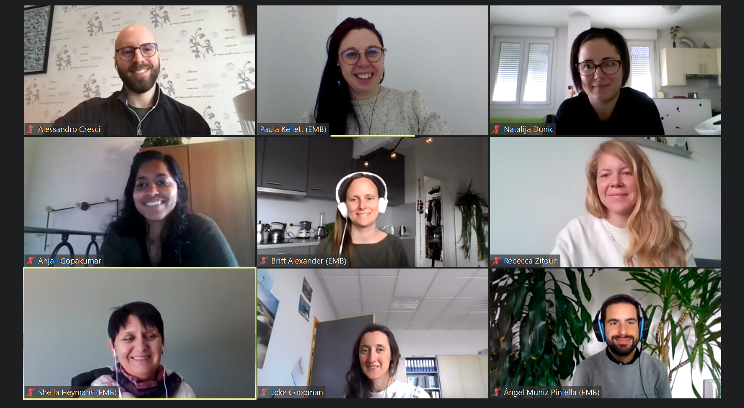
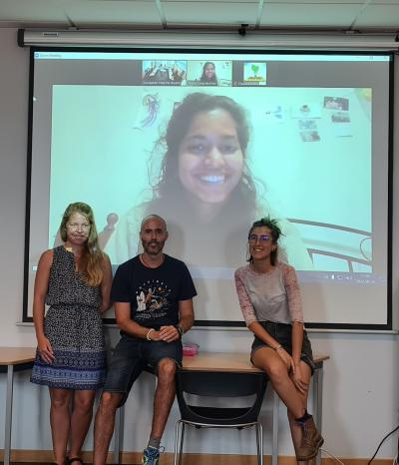
Thank you for listening!

