Slide 1
Marine Genetic Resources and
the Marine Biodiscovery Pipeline
Dr Jane Eva Collins
15th October 2022

Slide 2
Contents
Marine Genetic Resources (MGR)
  Opportunities
  Marine biodiscovery pipeline
  Challenges
UN Biodiversity Beyond National Jurisdiction (BBNJ) negotiations
  Timeline
  Elements
  MGR part
Resources
Q&A

Slide 3


Slide 4
Opportunity
Conus magus/ cone snail
Prialt for chronic pain (analgesic)
Ecteinascidia turbidinata/ sea squirt
Yondelis for soft tissue carcinoma
Halichondria okadai/ sponge
Halaven for breast cancer
Collins, J. et al., 2018. Blue Biotechnology, River Publishers Series in Renewable Energy. Figure adapted from Jaspars, M.

Slide 5





The Marine Biodiscovery Pipeline
SCIENCE & BUSINESS
LAW
BUSINESS

Slide 6
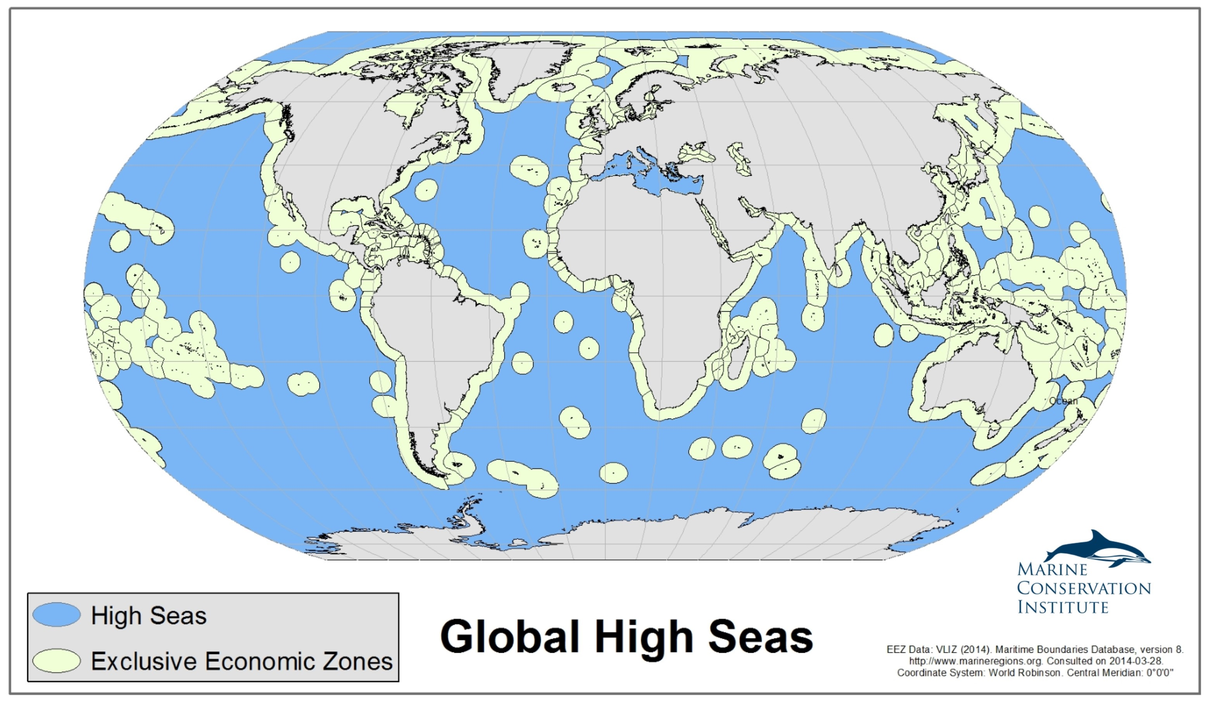
Areas Beyond National Jurisdiction (ABNJ)
Vlaams Instituut voor de Zee, 2014.

Slide 7
Access
Benefit-Sharing
ABS Information Kit produced and published by the CBD secretariat (2011)

Slide 8
Areas Beyond National Jurisdiction (ABNJ)
Vlaams Instituut voor de Zee, 2014.

Slide 9
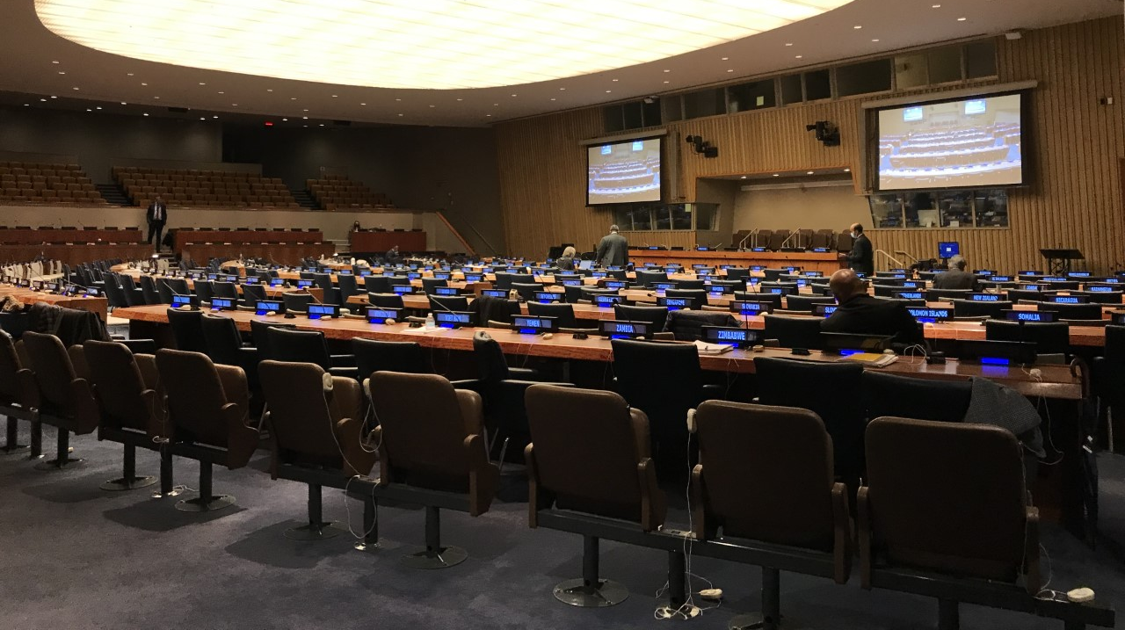
UN Negotiations on Marine Biodiversity Beyond National Jurisdiction (BBNJ)

Slide 10
UN BBNJ negotiations timeline
1982 – Ratification of the UN Convention on the Law of the Sea (UNCLOS)
2004 – Establishment of the Ad Hoc Open-ended Informal Working Group. Met 10 times between 2006 - 2015
2015 – States adopted a resolution to develop an international legally binding instrument under UNCLOS on the conservation and sustainable use of BBNJ. A Preparatory Committee (PrepCom) was established. Met 4 times between 2016 - 2017
2017 - the General Assembly convened an Intergovernmental Conference (IGC), under the auspices of the UN
September 2018 – IGC 1
March 2019 – IGC 2
August 2019 – IGC 3
March 2022 – IGC 4
August 2022 – IGC 5

Slide 11
Biodiversity Beyond National Jurisdiction (BBNJ) Negotiations
ABNJ: Areas Beyond National Jurisdiction

Slide 12
Marine genetic resources, including questions on the sharing of benefits – key elements
Definitions
Objectives
Scope of application
Notification
Fair and equitable sharing of benefits
Traditional knowledge
Intellectual property rights
Monitoring and transparency

Slide 13
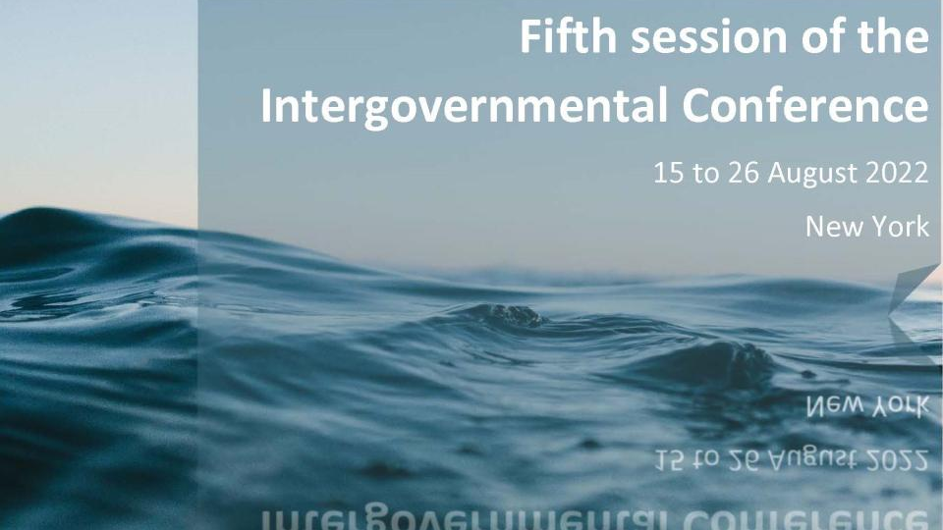

Slide 14
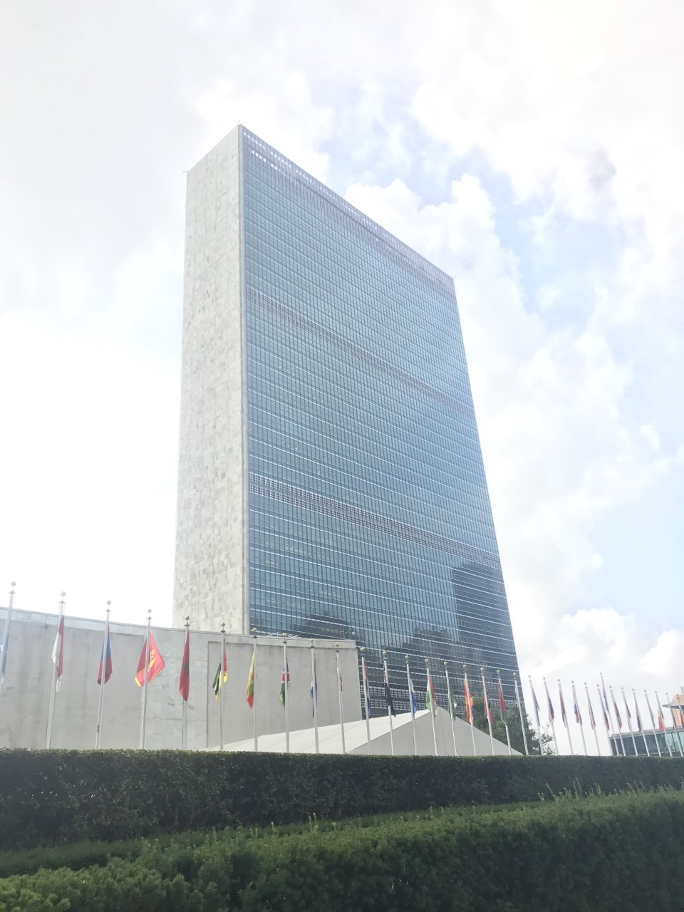
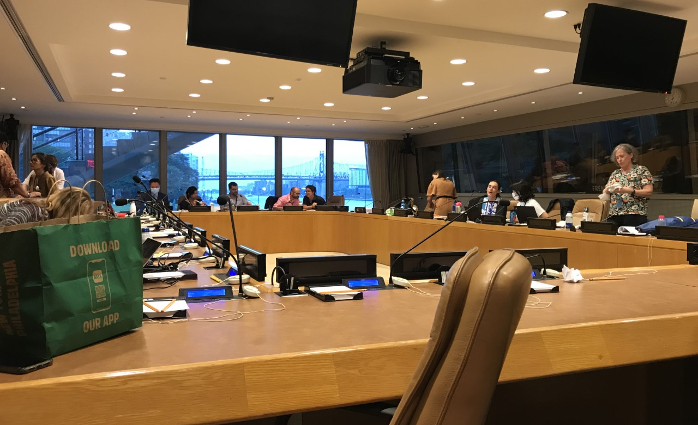
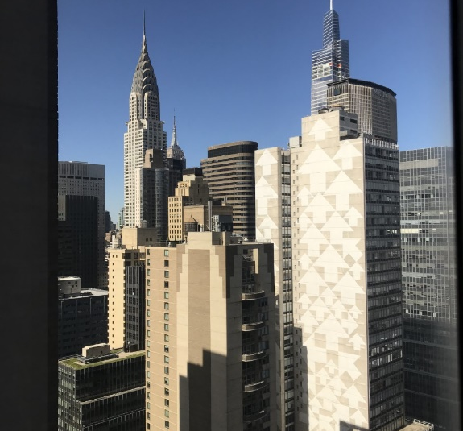
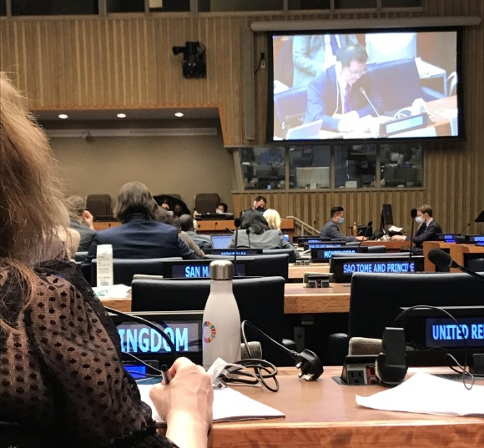
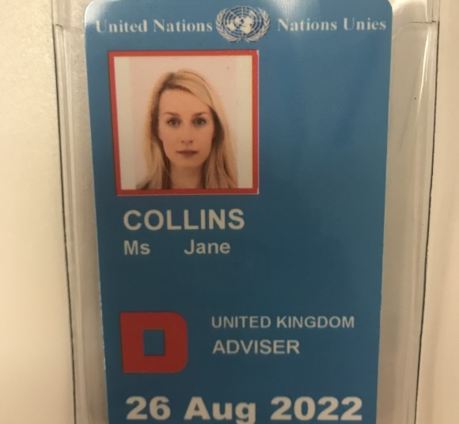

Slide 15
Marine genetic resources, including questions on the sharing of benefits – elements requiring further discussion
Definitions
Objectives
Scope of application
Notification
Fair and equitable sharing of benefits
Traditional knowledge
Intellectual property rights
Monitoring and transparency

Slide 16
Marine genetic resources, including questions on the sharing of benefits – elements requiring further discussion
Definitions
  Collection
  Access ex situ
  Utilisation
Scope of application
  Temporal scope
  Material scope
Fair and equitable sharing of benefits
  Types of benefits to be shared
    Non-monetary benefits
    Monetary benefits

Slide 17
UN BBNJ negotiations timeline
1982 – Ratification of the UN Convention on the Law of the Sea (UNCLOS)
2004 – Establishment of the Ad Hoc Open-ended Informal Working Group. Met 10 times between 2006 - 2015
2015 – States adopted a resolution to develop an international legally binding instrument under UNCLOS on the conservation and sustainable use of BBNJ. A Preparatory Committee (PrepCom) was established. Met 4 times between 2016 - 2017
2017 - the General Assembly convened an Intergovernmental Conference (IGC), under the auspices of the UN
September 2018 – IGC 1
March 2019 – IGC 2
August 2019 – IGC 3
March 2022 – IGC 4
August 2022 – IGC 5
? – IGC 5bis

Slide 18
Resources
Publications
Collins, J.E., Rabone, M., Vanagt, T., Amon, D., Gobin, J. and Huys, I., 2021. Strengthening a Global Network of Marine Biological Collections: Recommendations for Biodiversity Beyond National Jurisdiction. ICES Journal of Marine Science
Collins, J.E., Sirakaya, A., Vanagt, T. and Huys, I., 2020. Developing a Methodology to Balance Benefit-Sharing: Application in the Context of Biodiversity Beyond National Jurisdiction. Genetic Resources
Collins, J.E., Vanagt, T. and Huys, I., 2020. Stakeholder Perspectives on Access and Benefit-Sharing for Areas Beyond National Jurisdiction. Frontiers in Marine Science, 7, p.265.
Collins, J.E., Vanagt, T., Huys, I. and Vieira, H., 2020. Marine Bioresource Development-Stakeholder's Challenges, Implementable Actions and Business Models. Frontiers in Marine Science, 7, p.62.
Collins, J.E., Harden-Davies, H., Jaspars, M., Thiele, T., Vanagt, T. and Huys, I., 2019. Inclusive innovation: Enhancing global participation in and benefit sharing linked to the utilization of marine genetic resources from areas beyond national jurisdiction. Marine Policy, 109, p.103696.
Rabone, M., Horton, T., Harden-Davies, H., Zajderman, S., Appeltans, W., Droege, G., Brandt, A., Pardo Lopez, L., Dahlgren, T.G., Glover, A. and Collins, J.E, 2019. Access to Marine Genetic Resources (MGR): raising awareness of best-practice through a new agreement for Biodiversity Beyond National Jurisdiction (BBNJ). Frontiers in Marine Science, 6, p.520.
Collins, J.E., Broggiato, A. and Vanagt, T., 2018. Blue Biotechnology. Building Industries at Sea: 'Blue Growth' and the New Maritime Economy. River Publishers
Websites
https://www.un.org/bbnj/
https://enb.iisd.org/marine-biodiversity-beyond-national-jurisdiction-bbnj-igc5

Slide 19
Thank you for listening!

